Slide 2
How to Cultivate a Relationship with your Business Manager
…and why it matters!

Slide 3
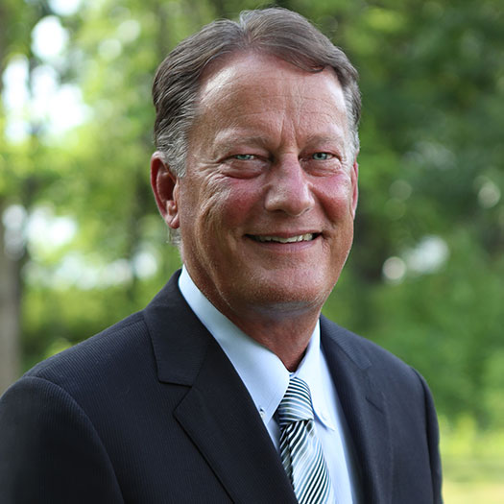
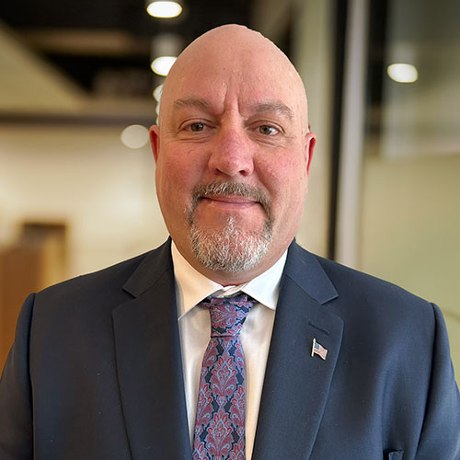
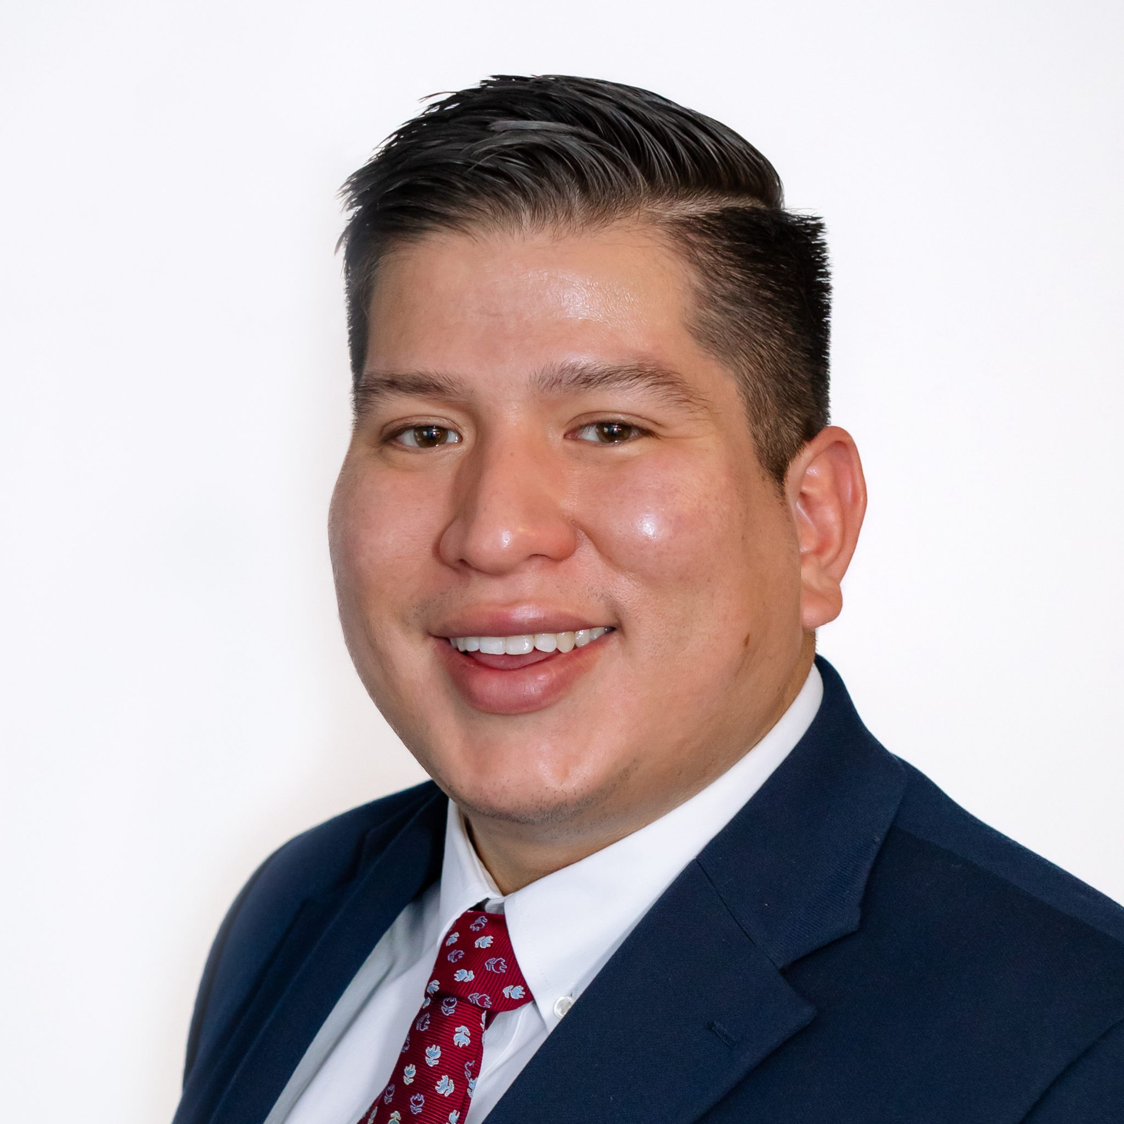
Don Laffoon
Electrical Corp. of America
NECA District 7 VP
Paul Flynn
Field Representative
Western Region NECA
Richard Padilla
Executive Director
Atlantic Coast Chapter NECA

Slide 4
How to Cultivate a Relationship with your Business Manager
…and why it matters!

Slide 5
Thank you!

