Slide 2
Fleet Management Safety Roundtable

Slide 3
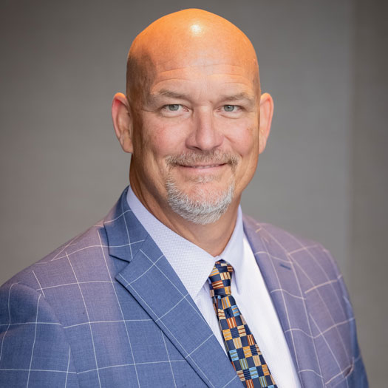
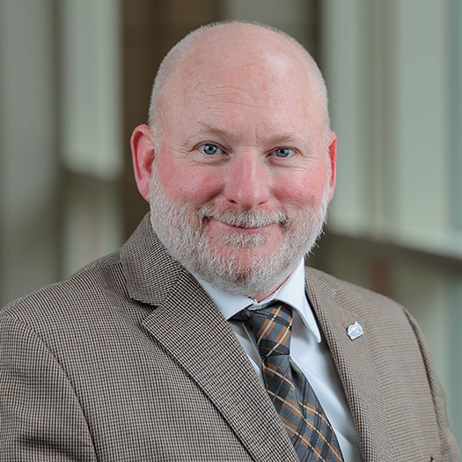
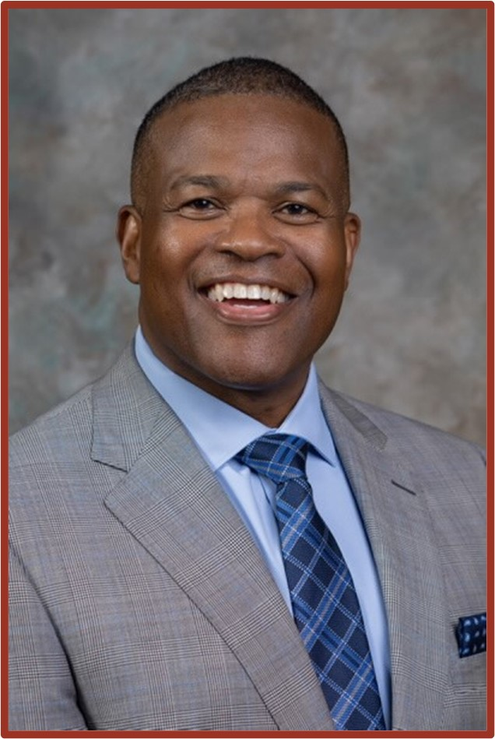
Jef Fagan
NECA SVP Labor Relations & Risk Management
Mike Starner
NECA Exec. Dir. Outside Line Safety
Josh Chard
Altec, Inc.
Patrick Cunningham
Federated Insurance

Slide 4
Fleet Management Safety Roundtable

Slide 5
Thank You

