Slide 2
Panel: Data Driven Negotiations

Slide 3
The cast of characters…
Ryan Courtney NECA Exec. Dir. Nat’l Labor Relations
Chase Pendergraft
Executive Director
Tennessee Chapter, NECA
Luke Kuhl
Executive Director
St. Paul Chapter, NECA
Jason Walden
Executive Director
North Central Ohio Chapter, NECA

Slide 4
How do you prepare for negotiations?

Slide 5
What information/data do you collect?

Slide 6
How do you present it?

Slide 8
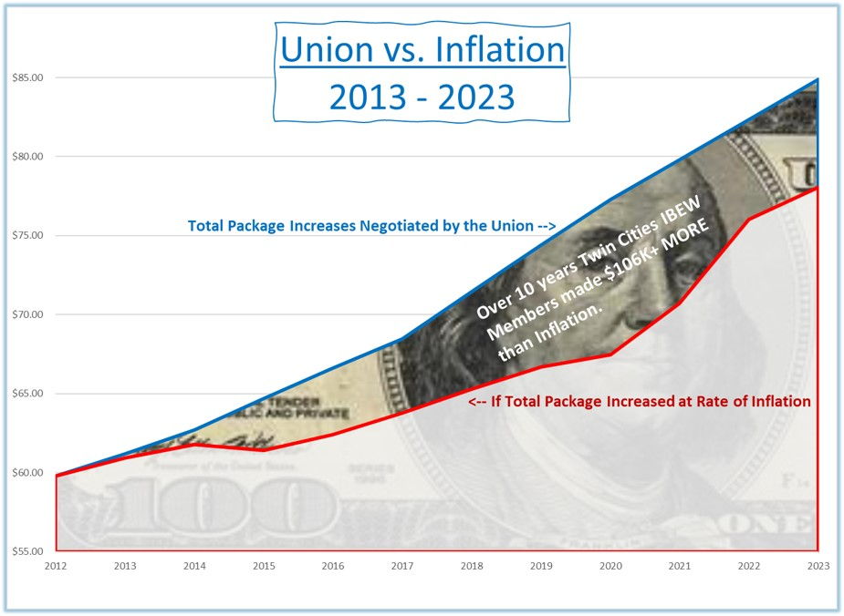

Slide 9
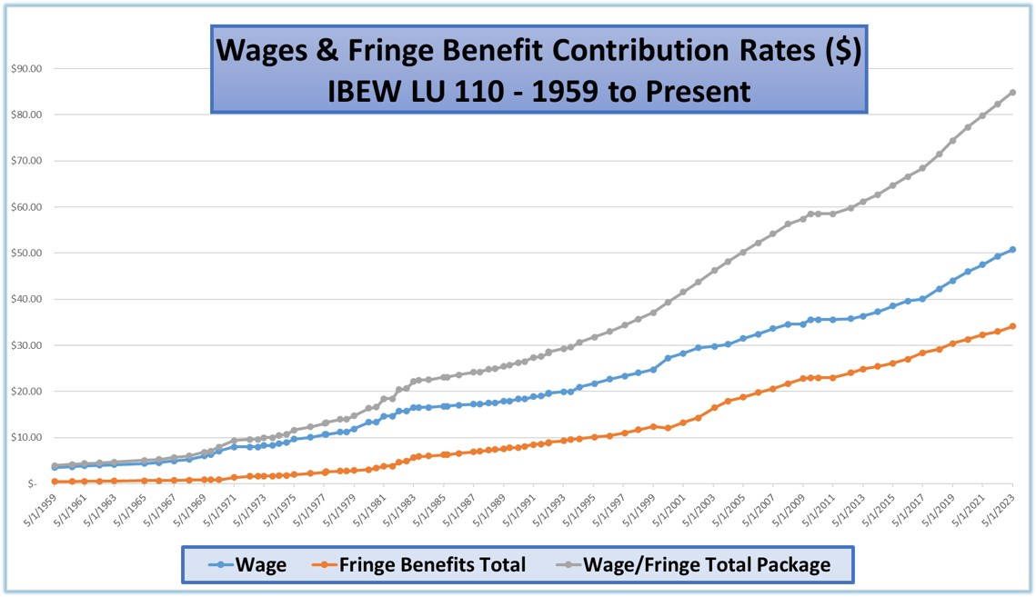

Slide 10
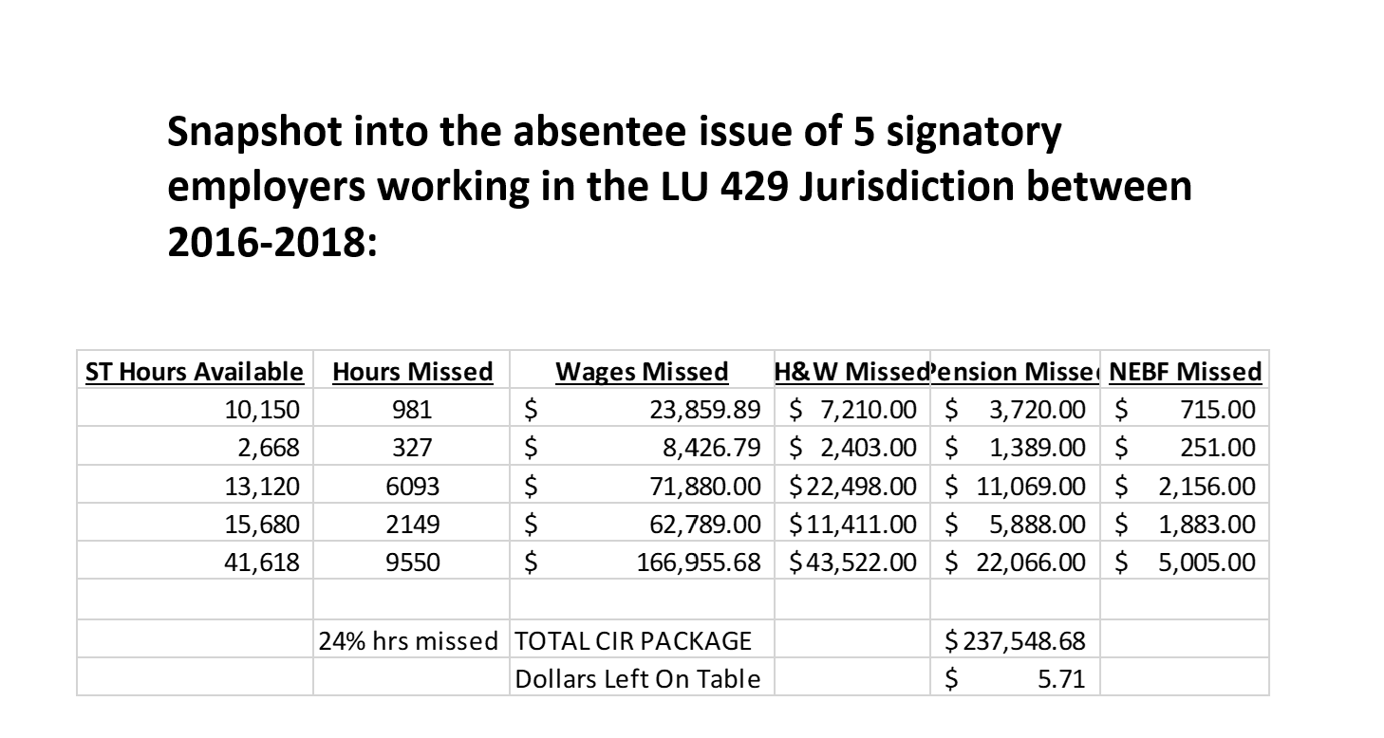

Slide 11
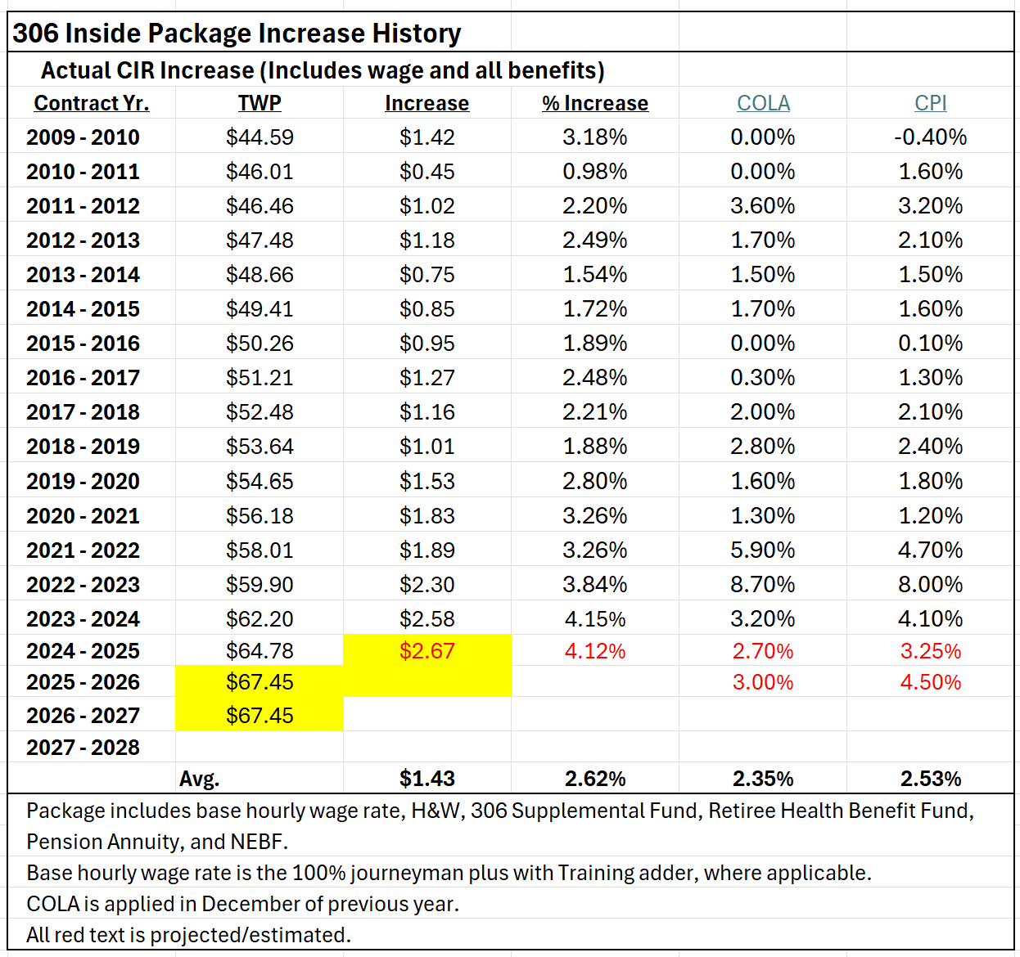

Slide 12
Any impactful stories with the data?

Slide 13
Disclaimer
This material is for informational purposes only. The material is general and is not intended to be legal advice. It should not be relied upon or used without consulting a lawyer to consider your specific circumstances, possible changes to applicable laws, applicable Collective Bargaining Agreements, prime contracts, subcontracts, rules and regulations and other legal issues. Receipt of this material does not establish an attorney-client relationship.

