Slide 2
Part II will cover “Negotiating with No” and “Getting to Yes”

Slide 3
Negotiating with No

Slide 4
Notes:
Objective: We have all experienced the rejection of our proposals, NO, NO, NO, NO. Use the rejections to solicit discussions and resolutions.

Slide 5
So, what happens next?
Why is a “No” response useful?
Because “No” unlocks negotiations.
It sets the ceiling and floor of your counterpart’s comfort level.
What should you do now?
Notes:
Objective: Accept No. Begin to pivot.

Slide 6
Reply to a “No” response with questions
What about this doesn’t work for you?
What would you need to make this work?
It seems there’s something here that bothers you. What is it?
Is there anything we can change so you can live with it?
Notes:
If you receive a no response, ask:
What about this doesn’t work for you?
What would you need to make this work?
It seems there’s something here that bothers you.
Is there anything we can change so you can live with it?
Being asked to say yes too soon makes people defensive

Slide 7
Solicit correcting actions
Correcting is irresistible
Correcting provides opportunities for positive discussions
Intentional or unintentional comments elicit responses
Notes:
Objective: When your statements or responses illicit “corrections”, whether intentional or unintentional, use them to expand the discussion. Use comments for affect. To the Presenter read the “clipboard comments” first. Ask participants if they have heard these responses before.

Slide 8
No may mean something else
I don’t understand how it helps our members
I’m uncomfortable with the proposal
I want to confer with someone else
I’d like something else
I can’t agree yet
I need more information
Notes:
Objective: Think critically, what’s really going on here?

Slide 9
Interpreting Irrational Behavior
Just because someone is acting poorly doesn’t mean they are crazy, more than likely, they…
…have concerns about ratification
…have incomplete or different information
…have hidden interests justifying behavior
…are attempting to get an ill-advised response
…are attempting to “Label” your comments
Notes:
Objective: Just because someone is acting crazy doesn’t mean they are crazy there are other reasons

Slide 10
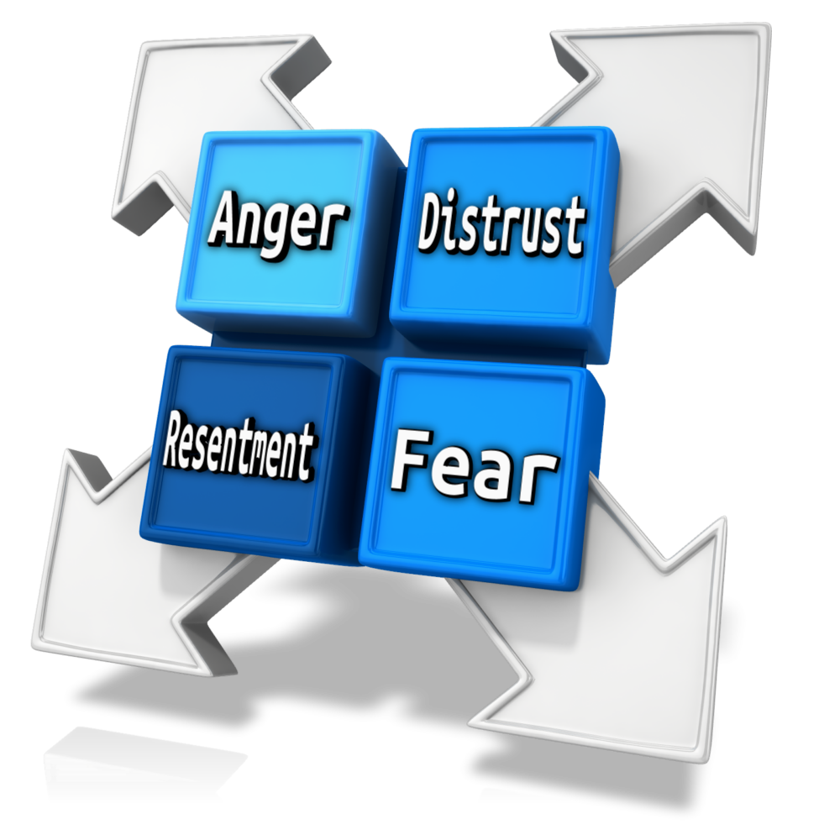
Labeling
Labeling validates their emotions by acknowledging it
Avoid negative comments
Start with:
It seems like…
It sounds like…
It looks like…
After filling in the blank, pause, let the union negotiators fill in the silence
Notes:
Objective: Labeling indicates you are concerned; your questions should stimulate dialogue that may result in a solution or an alternative satisfying their needs.

Slide 11
Mirroring
Creates a sense of similarity
Facilitates bonding and understanding
Don’t prepare a counter argument
Your primary focus is what the other person says
Mirror their most critical words
Be silent for a few moments
Wait for a response
Notes:
If you receive a no response, ask:
What about this doesn’t work for you?
What would you need to make this work?
It seems there’s something here that bothers you.
Is there anything we can change so you can live with it?
Being asked to say yes too soon makes people defensive

Slide 12
Building Bridges
Labeling
Lays the Foundation
Mirroring
Completes the Connection
Notes:
Objective: Labeling lays the foundation of the relationship; Mirroring completes the connection between the Union and Managment

Slide 13
Deadlines Create Responses
Deadlines make people act impulsively
Resist the urge to rush
Take advantage of the time constraints
Use deadlines to focus on loss aversion
Notes:
Objective: Understand you may not settle until the very end, but it can be leveraged if you keep your cool.

Slide 14
Loss Aversion - It’s in every Agreement
The strongest human bias is “Loss Aversion”
People will take more risks to avoid a loss than they will to realize a gain
A withdrawal of an offer may be better than the alternative
Notes:
Objective: Is a bird in the hand worth two in the bush. Studies have suggested that losses are twice as powerful, psychologically, as gains. This principle is known as loss aversion. A settlement offer may not resolve all their issues, but a withdrawal of an offer may be better than the alternative.

Slide 15
Getting to Yes
Notes:
Objective: Utilizing the Harvard Negotiation Project’s principles to achieve an agreement

Slide 16
Positional Bargaining
Doesn’t meet the needs of either party
Doesn’t include legitimate interests
Results in only small concessions
Limits time to discuss concerns
Strains parties’ relationship
Leads to impasse
Notes:
Objective: The Orange Peel and Fruit story

Slide 17
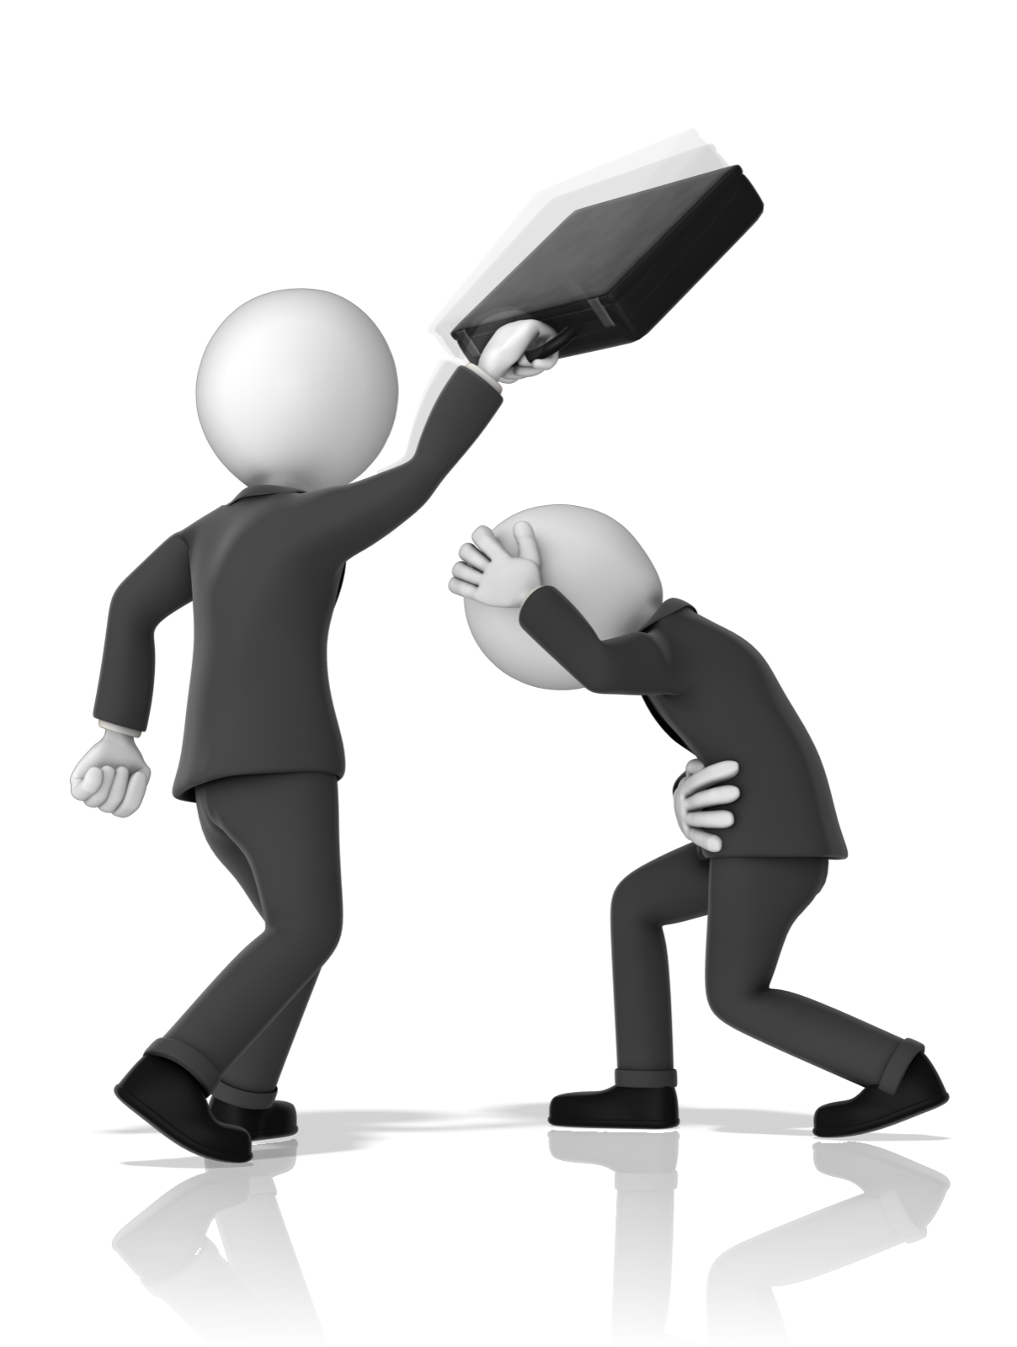
Good relationships work better
Develop a relationship before negotiations
Live by the “Golden Rule”
Focus on the industry in every discussion
Its about the future not the past
Human reactions can be disastrous
Notes:
Objective: Friendship lends itself to compassion not confrontation.

Slide 18
Human Reactions
Communication
Perception
Emotion
Notes:
Objective: Read slide – it segues into the next three.

Slide 19
Perception
Your reality vs. their perceptions
Why they believe what they believe
Communicate your views and beliefs clearly
Union Perception - Full employment
Industry Reality - Market share is flat
Notes:
Objective: There’s a difference in your reality and their perceptions Recognize their point of view and why they believe it. Communicate your views and beliefs clearly.

Slide 20
Emotion
Understand the Business Manager’s needs
They seek appreciation
They seek recognition
They seek status
Listen intently before reacting to emotional comments
Recognize political realities
Notes:
Objective: But they, like you, have personal feelings, fears, hopes, and dreams; take note of how they feel, too.
Appreciation (to be recognized and valued), affiliation, role (to have a meaningful purpose), and status (to be fairly seen and acknowledged).
Think about whether your counterpart may be experiencing a threat to their identity, or their self-image or self-respect, from what you have said or what you might say.
But do not react to any emotional outbursts.

Slide 21
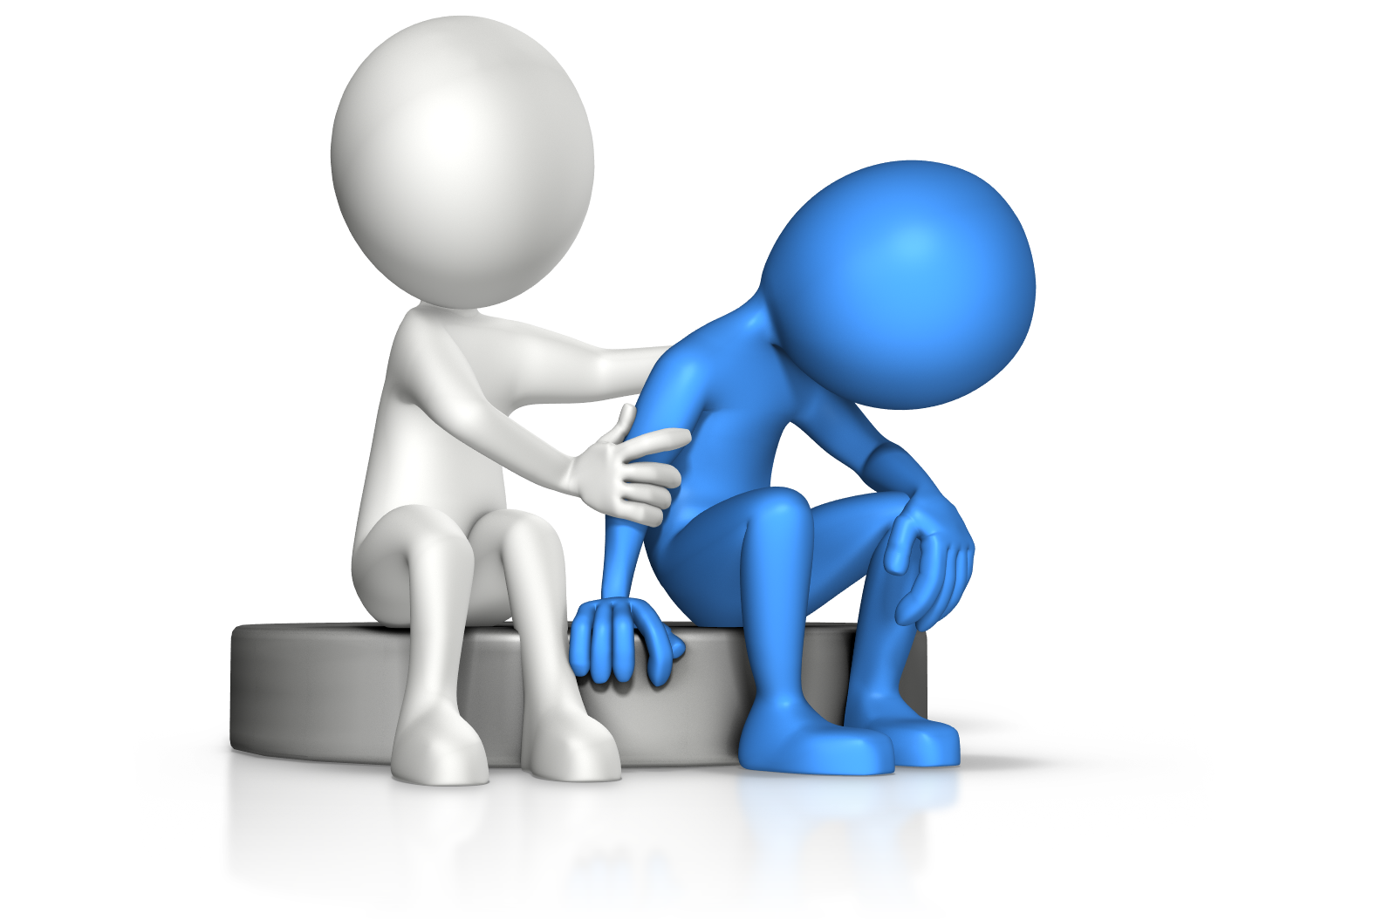
Communication
This is the most important skillset
Requires active listening
Elicits responses
Impacts perception
Leads to consensus
Notes:
Objective: Communication requires listening
Actively listen - reiterate what they said, help them be heard and understood
Effective negotiations elicit responses
Understanding their perceptions, their needs and their constraints leads to consensus
This is the most important negotiation skillset
Human nature makes us hear only what we want to hear.
Learning to listen is one of the most important negotiating tools.

Slide 22
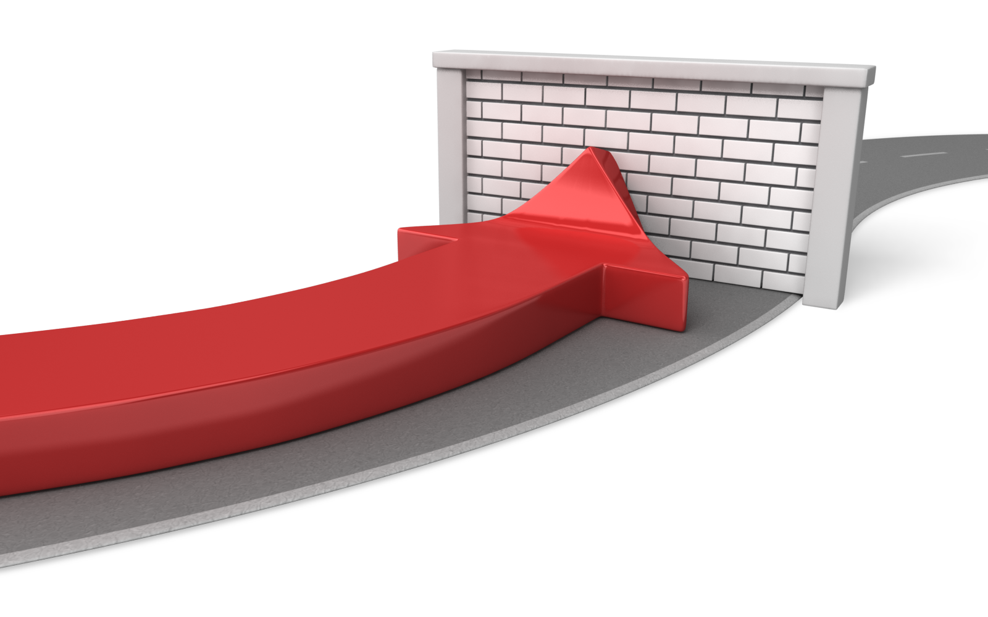
Human reactions create obstacles
Searching for a single answer
Judging prematurely
Assuming a fixed pie
Believing solving their problem is their problem
Being too rigid in your solutions
Notes:
Objective: Collaboration is the result of recognition of interests.
Explore all possible solutions BEFORE deciding
The more options, the more the likelihood of acceptance
Best industry outcomes are created in a joint capacity
Looking for the single best answer, you will overlook a wiser decision-making process which you could select a larger number of possible answers
Avoid focusing on a perceived finite market.
Bargaining is not market redistribution.
There’s always more market. Always.
Grow the pie before dividing it.
Skill at inventing options is one of the most useful assets that a negotiator can have

Slide 23
The Bottom Line
Your best offer today will be the starting point tomorrow
Have a bottom line, or the worst acceptable outcome
Be cautious of a “bottom line rigidity”
Understand your BATNA
Notes:
Objective: Be able and committed to walking away. Know your alternatives.

Slide 24
Best Alternative To a Negotiated Agreement
What is your BATNA?
Any flexibility
Wait for the Interim
Let CIR decide
Withdraw
Walk away
Strike/Lockout?
Measure all proposals against your BATNA
Notes:
Objective: The impact of no-settlement
It is not only a better measure but is flexible enough to permit the exploration of imaginative solutions.
If both sides have attractive BATNAs, the best outcome for both parties may well be to not reach an agreement
A back up plan, not a fallback option.

Slide 25
Go to the Balcony
Notes:
Objective: A place where you can:
Get out of the heat
Step back and manage emotions
Reflect about taking negotiation to the next level

Slide 26
The Victory Speech
Notes:
Objective: Make it sellable to the IBEW membership

Slide 27
Questions, comments, let’s talk!

Slide 28
Thank you!
Ian Andrews | ian.andrews@necanet.org

