Slide 2
Collaborative Bargaining
Customer Issues
Customer
Does Not Include IBEW
Does Not Include NECA
Common Area
NECA
NECA Resolutions
IBEW Resolutions
IBEW
Does Not Include Customer
Notes:
Objective: Find the common goals from intersecting interests though Collaboration.

Slide 3
Part I will cover “The Committee” and “At the Table”
Part II will cover ”Negotiating with No” and “Getting to Yes”

Slide 4
The Negotiating Committee

Slide 5
Toiling with 133 years of tradition
1891
1901
2024
Notes:
Objective: Demonstrate the history and traditions of the IBEW.
Founded in 1891,
NECA founded in 1901
Wagner Act passed in 1935 creating federal support of labor activities
Taft-Hartley Amendment in 1947 modified some language in favor of Management
And in 2021 Management negotiators attempting change in 130 years of tradition and entrenched bias against change
And they are trying to convince them over a period of 30 hours or so
...not going to happen without long term commitment and interaction

Slide 6
Those being represented
All customers
All market segments
All signatory employers and their families
All employees and their families
All communities
Notes:
Objective: The entire industry has interest in what is being done at bargaining and its impact to their business and lives

Slide 7
Collective Bargaining is not:
Getting even
Being uncompromising
Winning at all costs
Prioritizing personal interests
Focusing on the IBEW’s positions only
Notes:
Objective: Keep personal issues out of the negotiating process

Slide 8
What’s below the surface?
Shift your focus from positions what they want to understanding why they want something
Know your interests!
Absolutely critical interests
Less Critical but important
Non-Critical, can continue without them
Notes:
Objective: Seek out the unstated interests beyond the positions and proposals

Slide 9
Four Types of Negotiators
Analyst
Accommodator
Assertive
Achiever
Notes:
Objective: Types of negotiators and how to deal with them. These “types” are loosely based on the Black Swan Group negotiation materials. The 4th was suggested during this seminar’s Beta Testing with two separate chapters.

Slide 10
Analyst
Cares About: | Confirming Facts & information |  | Negotiation Mindset: | Time = Preparation Silence = Time to think
Characteristics: | Methodical & diligent Hates surprises Self-image tied to minimizing mistakes Skeptical by nature |  | May appear to agree when just thinking about it Apologies have little value Hypersensitive to reciprocity
Tools to Use: | Labels, specifically to compare analysis |  | Use data to explain your reasons, no ad-lib
Notes:
Objective: Discuss all bullet points with emphasis on the Mindset bullet points. Left are characteristics; Right side are reactions. Presenters should read the Black Swan method.

Slide 11
Accommodator
Cares About: | Building relationships |  | Negotiation Mindset: | Time = relationship building Silence = upsetting, indicates anger
Characteristics: | Happy when communicating Sociable, peace-seeking, optimistic |  | Watch tone & body language, they won’t express hesitancy in words Risk: may over compromise, agree to give you something they can’t deliver
Tools to Use: | What & How calibrated questions focused on implementation
Notes:
Objective: Discuss all bullet points with emphasis on the Mindset bullet points. Left are characteristics; Right side are reactions. Presenters should read the Black Swan method.

Slide 12
Assertive
Cares About: | Being heard | Negotiation Mindset: | Time = money Silence = opportunity to speak more | Time = money Silence = opportunity to speak more
Characteristics: | Perfecting the solution is less important than getting it done Loves winning above all else | Emotions can cloud decision-making faculties Focus first on what they have to say. They will only listen if they are convinced you understand them
Tools to Use: | Calibrated questions Labels Summaries | Be careful with reciprocity, if you give an inch, they may take a mile
Notes:
Objective: Discuss all bullet points with emphasis on the Mindset bullet points. Left are characteristics; Right side are reactions. Presenters should read the Black Swan method.

Slide 13
Achiever
Cares About: | Communicating with all | Negotiation Mindset: | Time = opportunity Silence = contemplative | Time = opportunity Silence = contemplative
Characteristics: | Great communicator Skilled at listening Skilled at responding | Shows emotions when useful Views negotiations as a means to achieve an agreement
Tools to Use: | Calibrated questions | Responds after consideration is given Uses all tools of the other three
Notes:
Objective: Discuss all bullet points with emphasis on the Mindset bullet points. Left are characteristics; Right side are reactions. Presenters should read the Black Swan method.

Slide 14
A moment of reflection
What is your role for the committee?
What is your expertise?
What relationships can you leverage?
Notes:
Objective: Interact with the attendees to answer the questions on the screen.

Slide 15
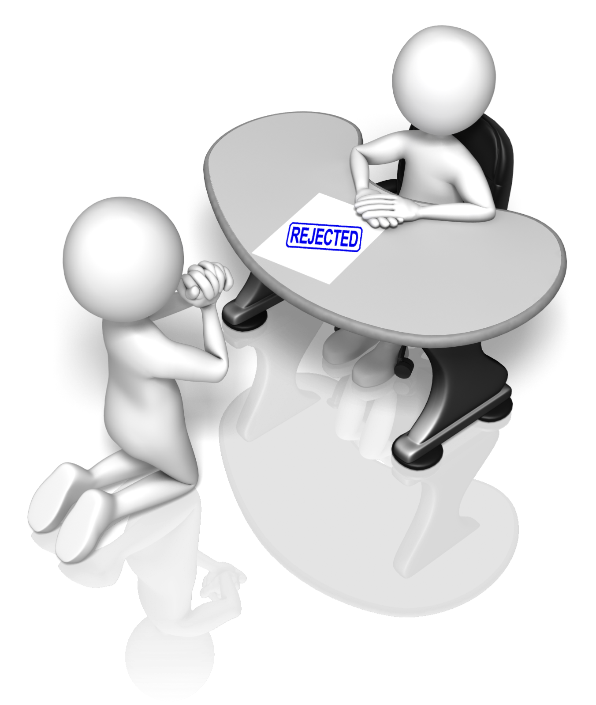
Mental strength
Prepare for offers to be rejected
Work on emotional intelligence
Practice mental preparation
Rejection is not a personal attack
Notes:
Objective: How to prepare for and handle rejection at the table.

Slide 16
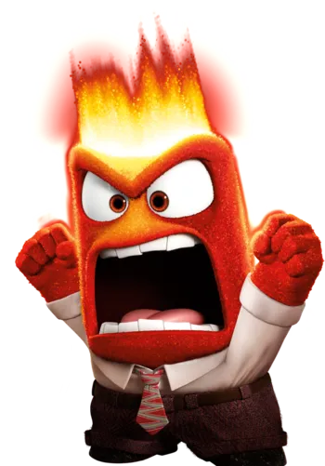
Trigger Exercise
What triggers — words, situations or conditions — cause you to react with strong emotions or lose your cool?
Why?
What physical clues does your body give you that you are losing your cool?
Notes:
Objective: Anger management

Slide 17
What are your goals?
Notes:
Objective: Ask participants what their goals are. NOTE: GOALS are never completely attained.

Slide 18
The customer is the common denominator of bargaining
The Committee should focus on improving efficiency
The Committee should focus on improving service
The Committee should focus on improving their product
Notes:
Objective: Stress the CUSTOMER from whom all wealth flows.

Slide 19
How can the industry be improved?
Will a proposal improve market share?
Will a proposal help recruit and put more people to work?
Will a proposal improve efficiency and increase competitiveness?
Will a proposal increase membership for both parties?
Notes:
Objective: Stress the CUSTOMER from whom all wealth flows.

Slide 20
Management Rights and Bargaining
Section 2.12 - The Union understands the Employer is responsible to perform the work required by the owner. The Employer shall therefore have no restrictions, except those specifically provided for in the collective bargaining agreement in planning, directing and controlling the operation of all his work, in deciding the number and kind of Employees to properly perform the work, in hiring and laying off Employees, in transferring Employees from job to job within the Local Union's geographical jurisdiction, in determining the need and number as well as the person who will act as Foreman, in requiring all Employees to observe the Employer's and/or owner's rules and regulations not inconsistent with this Agreement, in requiring all Employees to observe all safety regulations, and in discharging employees for proper cause.
20
M
Notes:
Objective: Any additional language usually results in loss of Management Rights.

Slide 21
Consensus by Degrees
Question Everything
Endorse Completely
100%
Agree with Reservation
75%
Don’t Like Won’t Block
25%
Support with Mixed Feelings
50%
Veto
the Proposal
0%
Notes:
Objective: All topics should be discussed in caucus and/or prior to any concession or agreement.

Slide 22
Bargaining at the Table
Notes:
Objective: What is it like as a committee member at the table with the IBEW. What to expect and how to be successful.

Slide 23
Recognize Union Goals
Maximum advantage for the employee
Improve members’ wages and benefits
Best working conditions for workers
Notes:
Objective: Don’t take it personally. They are at the table for a reason. MONEY

Slide 24
Exchanges
When will you exchange proposals? This can set the tone
Prior to the 1st meeting?
At the 1st meeting?
Other agreed to times?
Notes:
Objective: Understand the exchanging of proposals and how the process starts. Have a plan to proceed.

Slide 25
Control the Process
Select neutral location
Create meeting agenda
Determine bargaining authority
Verify ratification
Establish the wage package
Exchange of ideas freely
Going off the record
Notes:
Objective: Control the process to elicit progress
Establish neutral location if necessary
Determine authority to bargain to conclusion
Verify ratification process
Mirror ratification if crucial
Establish the wage package
Free exchange of ideas – common pledge
Off the record stays off the record
Determine bargaining process
Is it “Line Item” – what’s first
Is it “General” – determine “off the record”

Slide 26
Proposals and Discussions
Spokesperson introduces proposals and conducts the discussion
Committee members strategically participate
Unless previously agreed, divergent opinions discussed in caucus
Use the “talking stick” principle to calm the discussion
Notes:
Objective: Know and maximize your role at the table.

Slide 27
Line-Item Bargaining vs Package Bargaining
Every item discussed individually on its own merit
Numerous proposals tied together (think $ at the end)
Notes:
Objective: How to address each item at the bargaining table, specifically and individually.

Slide 28
Evaluating Proposals
Can it be bargained?
Is the issue merely a decoy?
Impact on all employers?
Does it encroach on Management Rights?
Discuss after the meeting!
Rank proposals after each session.
Notes:
Objective: When you make an offer to settle don’t counter-offer until you receive their counter-offer first.

Slide 29
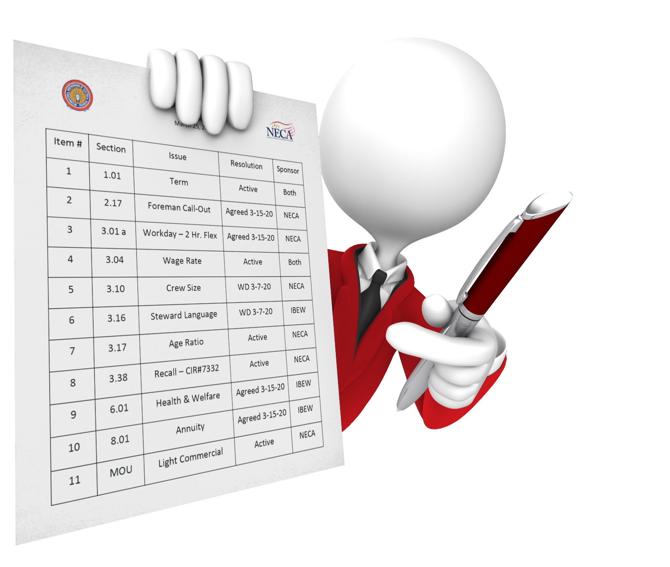
Proposal Tracking
Track Proposals - Improve the Process
Notes:
Objective: A better organize approach allows more time for important items and eliminates confusion during “package proposals”.

Slide 30
Use Caucuses
Timing is important
Controlled participation
Discuss proposals privately
Discussion of new ideas in caucus only
Notes:
Objective: Caucus involves the whole team and improves consensus
Timing is important, a caucus can serve to cool tempers
Controlled participation is encouraged
The parties discuss proposals privately
Discussion of new ideas or statements occurs only in caucuses

Slide 31
Utilize Sidebars
Off-the-record ONLY!
What are they?
Why are they important?
What should be avoided?
How and when to use them?
What authority should be granted?
Notes:
Objective: Off the record conversations can lead to great progress. Trust your representative.

Slide 32
Check body language
Designate an observer
Look for non-verbal clues
Listen, don’t talk
Try to understand the other party
Notes:
Objective: You miss everything you don’t try to see. Body language can be more telling than words.

Slide 33
Don’t bargain with yourself!
Final Offer
3.85% TPKG
1 Yr. Term
Ratio 1:7
Final Offer²
5.00% TPKG
2 Yr. Term
Ratio 1:4
Notes:
Objective: When you make an offer to settle don’t counter-offer until you receive their counter-offer first.

Slide 34
Use the Minutes
Summation, not transcription
Date and attendees
Items discussed
Decisions reached and signed
Future actions and next meeting
Exchange electronically after each meeting
Sign the minutes at the final meeting
Notes:
Objective: An agreement is only as good as it’s written. Keeps operations moving smoothly and keep all parties honest with records.

Slide 35
Bad Faith
Delaying settlement
Denying Union rights
Derailing negotiations
No real intent to negotiate
Bad Faith is demonstrated by a totality of actions and the importance of the issue
Notes:
Objective: briefly explain what the NLRB considers proper bargaining tactics.

Slide 36
3rd Party Surveys
Market Share Analysis
Wage & Fringe Comparison
Contract Costing
Wage & Fringe Benchmark
Custom Reporting
Notes:
Objective: All 3rd party surveys should be done jointly with the IBEW Local Union to create acceptance of its results.

Slide 37
Avoid the “Rush to Happiness”
Obviously, a decision must be reached, but..
an early settlement may be interpreted as leaving something on the table
retain a deadline urgency
Don’t settle too soon
Notes:
Objective: Review, discuss and review again.
DON’T SETTLE TOO SOON
THEY WILL COME BACK FOR MORE

Slide 38
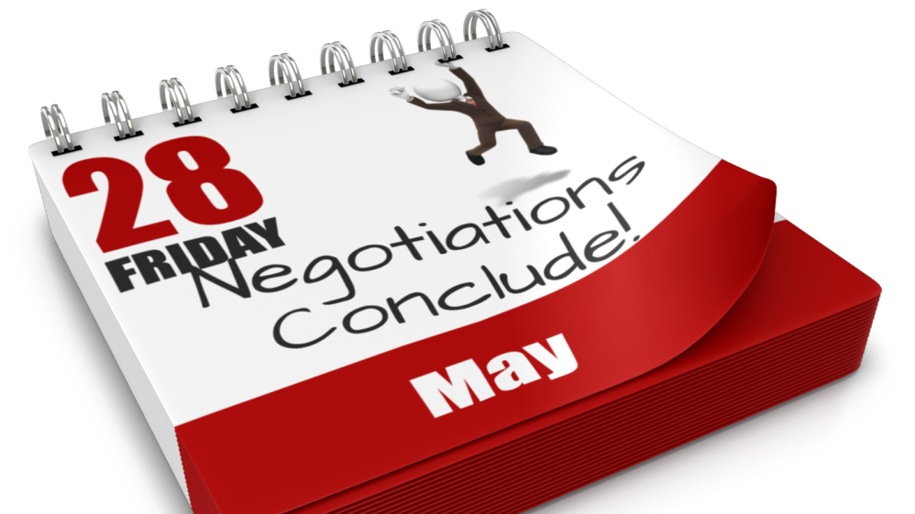
38
Notes:
Objective: The manager’s job never stops regarding negotiations

Slide 39
See you at Part II
Ian Andrews | ian.andrews@necanet.org

