Slide 2
Council on Industrial Relations
Submission Forms 101

Slide 3
The cast of characters…
Ryan Courtney NECA Exec. Dir. Nat’l Labor Relations
Steve Krieg
NECA VP Field Labor Relations Services
David Woodard
Midwestern Region Executive Director
Don Laffoon
Electrical Corp. of America
NECA District 7 VP

Slide 4
Completing the Forms
Do I have to fill in all of this information?

Slide 5
Yes.

Slide 7
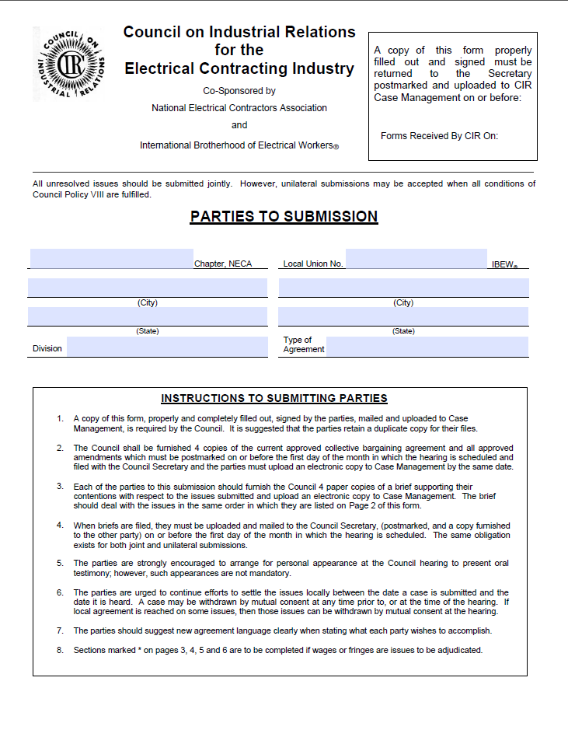
Let’s walk through the form…
Page One
Cover Page
Will be sent to the requesting party
Be sure all information is accurate
Confirm the city listed for the Local is the charter city
Can be found in Local Union Directory

Slide 8
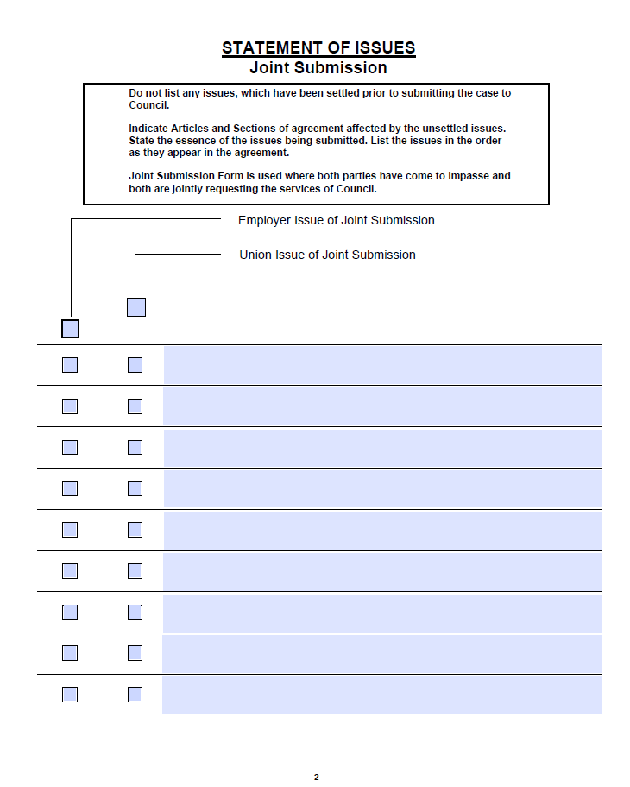
Let’s walk through the form…
Page Two
List Article, Section, and Title
Do not state positions here
Place in order of appearance in the briefs
Preferably in the order they appear in the CBA
Accurately designate who is moving the issue
Who proposed it? Who has authority to drop it?
Unilateral version is identical
Issues are just unilaterally submitted

Slide 9
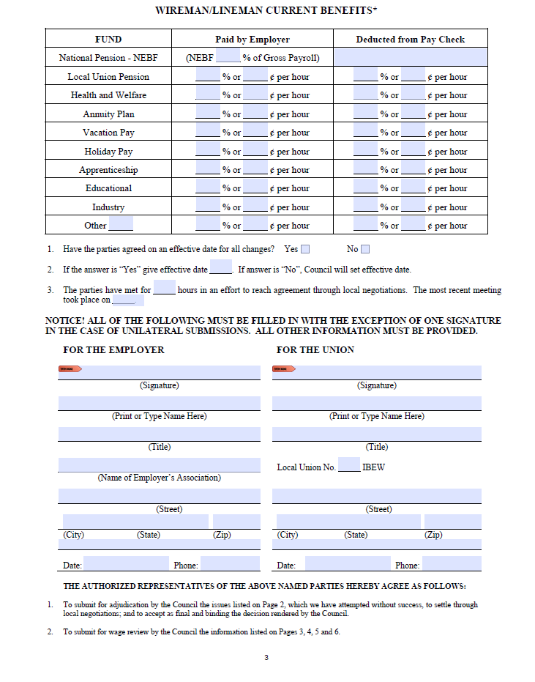
Let’s walk through the form…
Page Three
List all fringe contributions here
Pay close attention to percentage vs dollar amount
Provide an effective date if agreed
This question is commonly missed
Accurately list hours spent bargaining/discussing
If low, be prepared to explain
Sign…only after verifying ALL information

Slide 10
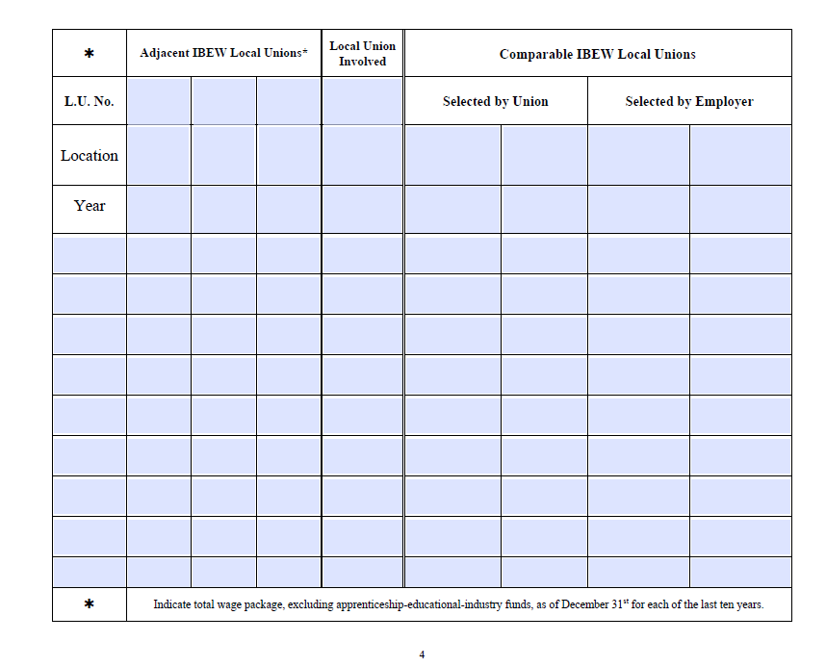
Let’s walk through the form…
Page Four
List all requested CIR packages here
CIR package defined at bottom of page
Adjacent means…adjacent
There has been some disagreement here
Comparable means similar
Membership (contractor & employees)
Type of work
Type of competition
Demographics

Slide 11
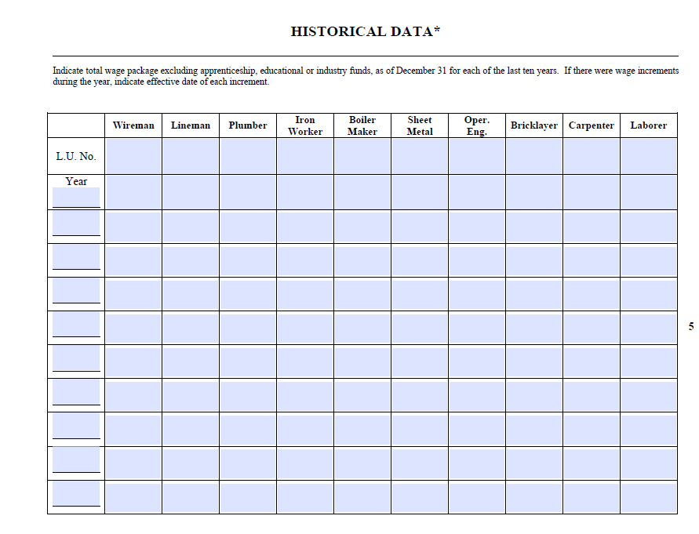
Let’s walk through the form…
Page Five
List all requested CIR packages here
CIR package defined at top of page
Does this all have to be completed?
Yes
Provides snapshot of what the other trades are doing

Slide 12
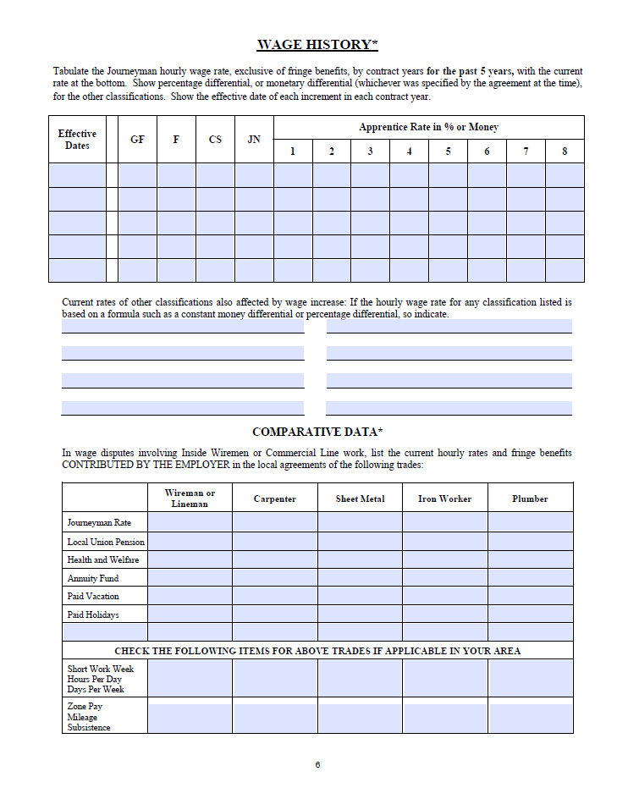
Let’s walk through the form…
Page Six
List all requested hourly wage rates
All boxes should be complete
Center portion often overlooked
Very critical when writing your decision

Slide 13
What now?
Double check all information on the form for accuracy
If one party filled in all information, verify it
Your signature means you certify it as accurate
Both parties sign the form
Upload the forms along with your briefs and relevant agreement to case management and mail four copies of each.
By midnight Eastern Time on the First of the Month in which the Session is held
February 1
May 1
August 1
November 1
Physical copies must be postmarked by the dates above
Continue meeting until your case is heard

Slide 14
Takeaways
Submission Forms provide a quick glance at the specifics for your case.
Accurate information is a MUST.
All fields must be complete.
Review thoroughly before signing.
What is on the paper is fact.
Be aware of filing deadlines.
There is no leeway here.
The parties are required to continue to meet weekly until their case is heard.
Category I Language

Slide 15
Final Thoughts
Settle Locally

Slide 16
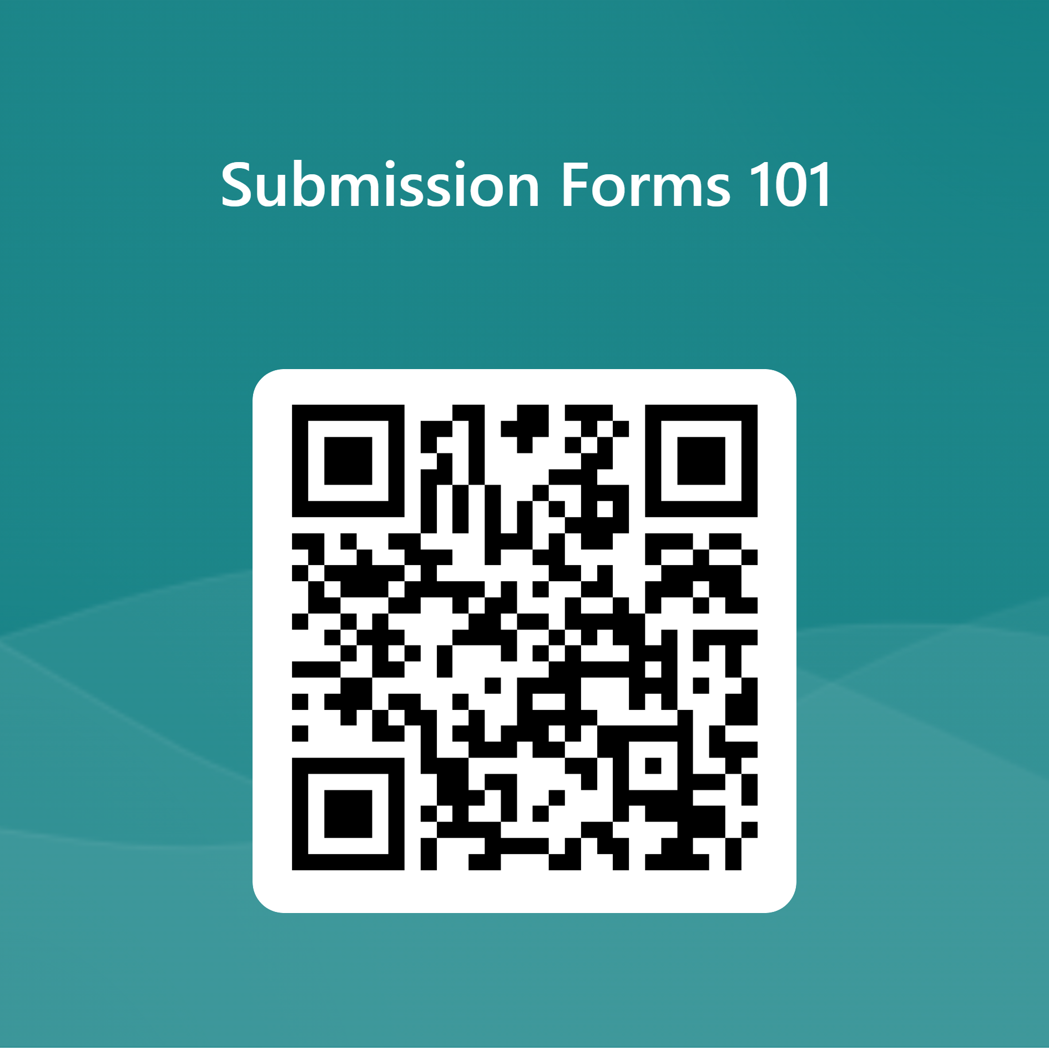
Feedback

Slide 17
Disclaimer
This material is for informational purposes only. The material is general and is not intended to be legal advice. It should not be relied upon or used without consulting a lawyer to consider your specific circumstances, possible changes to applicable laws, applicable Collective Bargaining Agreements, prime contracts, subcontracts, rules and regulations and other legal issues. Receipt of this material does not establish an attorney-client relationship.

