Slide 1

Training Requirements for the new Hazardous Communications Standard
Michael J. Johnston
Executive Director Standards and Safety

Slide 2

Continuing Education Units
NECA is an Authorized Provider by the International Association for Continuing Education and Training (IACET) and offers IACET Continuing Education Units (CEUs) for MEI programs that quality under the ANSI/IACET 1–2007 Standard.
0.15 CEUs = 90 minutes

Slide 3
Earning CEUs
To earn IACET CEUs for this training, attendees must attend 95% of the presentation.
Each attendee must take the learning assessment quiz and achieve a score of at least 75%.
Complete and submit an electronic evaluation upon completion of the training.

Slide 4
Objectives
Explain the need and use of a Global Harmonization System – GHS
Provide the required training for employees relative to the new label elements and new SDS format.
    Describe the hazard classification and signal words
    Provide a review of the new label requirements in the Hazardous Communication Standard – HCS
    Review the new criteria for safety data sheets – SDS

Slide 5
Overview
Exposure to hazardous chemicals is one of the most serious threats facing American workers today.
OSHA revised its Hazard Communication Standard (HCS) to align with the United Nations’ Globally Harmonized System of Classification and Labeling of Chemicals (GHS) and published it in the Federal Register in March 2012 (77 FR 17574).

Slide 6
Action and Timeline – Transition
Dec. 1, 2013 Train employees on new label elements and SDS format – Employers
June 1, 2015 Comply with modified provisions of the Final Rule – Manufacturers, Importers, Distributors, and employers.
June 1, 2016 Update alternate workplace labeling and hazard communication program as necessary and provide additional training for newly identified physical or health hazards.

Slide 7
Significant Revisions to HCS
Three significant changes contained in the revised standard include additional hazard classification, require the use of new labeling elements, and use of a standardized format for Safety Data Sheets (SDSs)
The new label elements and SDS requirements will improve worker understanding of the hazards associated with the chemicals in their workplace.

Slide 8
HCS Revisions
Hazard classification: Provides specific criteria for classification of health and physical hazards, as well as classification of mixtures.
Labels: Chemical manufacturers and importers will be required to provide:
  Label with a harmonized signal word
  A pictogram (graphic)
  Hazard statement for each hazard class and category.
  Precautionary statements

Slide 9
HCS Revisions
Safety Data Sheets: Will now have a specified 16-section format.
Information and Training: The final HCS will require that workers are trained within two years of the publication of the final rule to facilitate recognition and understanding of the new labels and safety data sheets.

Slide 10
OSHA Final Rule – Effective Date
12/1/13: All employees must be trained on new label elements and SDS format
6/1/15: Manufacturers and distributors must comply with all modified provisions except that distributors have until 12/1/15 to provide revised labels for all products shipped.
6/1/16: OSHA enforcement starts: Employers must update all labels and HazCom program, provide additional training for workers on newly identified physical or health hazards
Note: During transition period, employers can comply with old or new standard as far as labels and SDSs.

Slide 11
Required Training
To help companies comply with the revised standard, OSHA is phasing in the specific requirements over several years (December 1, 2013 to June 1, 2016).
By December 1, 2013 employers are required to train employees on the following:
  New labeling elements in HCS and,
  Standardized format for Safety Data Sheets (SDSs)

Slide 12
What is the GHS?
The Global Harmonization System (GHS) is a common and coherent approach to defining and classifying hazards, and communicating information on labels and safety data sheets.
Target audiences include workers, consumers, transport workers, and emergency responders.
Provides the underlying infrastructure for establishment of national, comprehensive chemical safety programs.

Slide 13
Why have a GHS?
Most countries are challenged with the requirement to specifically regulate all hazardous chemical products.
In the United States, there are an estimated 650,000 such products.
Adoption of uniform requirements for information to accompany the product helps globally address protection needs.

Slide 14
GHS Benefits
Promotes safer transportation, handling and use of chemicals and improve common understanding of hazards.
Helps protect workers, consumers and potential exposed populations globally.
Increases compliance and reduces costs for companies involved in national and international activities

Slide 15
What is an SDS?
SDS stands for Safety Data Sheets
Replaces the previous acronym MSDS – Material Safety Data Sheets
Essentially functions the same as before, but must include consistent elements.

Slide 16
Hazard Classification
Hazard determination/classification are self-classification processes – manufactures and importers must classify each chemical, determine appropriate hazard class and category based on evaluation of full range of available data/evidence.
  Appendix A defines health and physical hazards
  Appendix B includes parameters to evaluate health hazard data
  Appendix F pertains to carcinogens

Slide 17
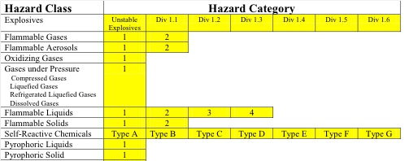
Physical Hazards
1910.1200 Appendix A (information in part)

Slide 18
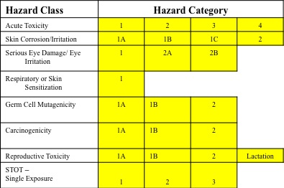
Health Hazards
1910.1200 Appendix A (information in part)
18

Slide 19
HazCom GHS Training
Training is integral hazard communication.
Systems should identify appropriate education and training for GHS target audiences who must interpret label and/or SDS information and take action in response to chemical hazards.
Training should address: workers, emergency responders, and those involved with preparation of labels, SDS and HazCom strategies as part of risk management systems.
Systems should also educate consumers in interpreting label information on products they use.

Slide 20
Label Information
Product Identifier
Signal Word
Precautionary Statement(s)
Name, address and phone number of the chemical manufacturer, distributor, or importer
Pictogram
Hazard Statement(s)

Slide 22
Product Identifier
How the hazardous chemical is identified.
Can be (but is not limited to) the chemical name, code number or batch number.
The manufacturer, importer or distributor can decide the appropriate product identifier.
The same product identifier must be both on the label and in Section 1 of the SDS (Identification).

Slide 23
Signal Word(s)
A signal word is used to indicate the relative level of severity of hazard and alert the reader to a potential hazard on the label.
Two signal words “DANGER” and “WARNING”
  Danger – Most severe degree of hazard
  Warning – Less severe than danger

Slide 24

Signal Word – Danger
Indicates an imminently hazardous situation which, if not avoided, will result in death or serious injury.
This signal word is to be limited to the most extreme situations.
This signal word should not be used for property damage hazards unless personal injury risk appropriate to this level is also involved.
ANSI Z535.3

Slide 25

Signal Word – Warning
Indicates a potentially hazardous situation which, if not avoided, could result in death or serious injury.
This signal word should not be used for property damage hazards unless personal injury risk appropriate to this level is also involved.
ANSI Z535.3

Slide 26
Signal Words (cont.)
There will only be one signal word on the label no matter how many hazards a chemical may have.
If one of the hazards warrants a “Danger” signal word and another warrants the signal word “Warning,” then only “Danger” should appear on the label.

Slide 27
Precautionary Statement(s)
Providing a statement describing recommended measures that should be taken to minimize or prevent adverse effects resulting from exposure to a hazardous chemical or improper storage or handling.
Example: Wear respirator, wear protective eyewear, Use in well ventilated area, etc.

Slide 28
OSHA Pictograms
OSHA’s required pictograms must be in the shape of a square set at a point and include a black hazard symbol on a white background with a red frame sufficiently wide enough to be clearly visible.
A square red frame set at a point without a hazard symbol is not a pictogram and is not permitted on the label.
OSHA has designated nine pictograms under this standard for application to a hazard category.

Slide 29









OSHA Pictograms
Circle Over Flame
Flame
Toxicity
Explosive
Corrosive
Gas Cylinder
Health Hazard
Environmental
Hazard

Slide 31
Hazard Statement(s)
Describes the nature of the hazard(s) of a chemical, including, where appropriate, the degree of hazard.
For example: “Causes damage to kidneys through prolonged or repeated exposure when absorbed through the skin.”

Slide 32
Hazard Statement(s)
All of the applicable hazard statements must appear on the label.
Hazard statements may be combined where appropriate to reduce redundancies and improve readability.
The hazard statements are specific to the hazard classification categories, and chemical users should always see the same statement for the same hazards, no matter what the chemical is or who produces it.

Slide 33
Hazard Statement Example
The employee should be instructed that with the new format, Section 8 (Exposure Controls/Personal Protection) will always contain information about:
  Exposure limits
  Engineering controls
  Ways to protect yourself
  Personal Protective Equipment - PPE

Slide 34
Label Quick Card

Slide 35
Safety Data Sheets – SDS
The Hazard Communication Standard (HCS) requires chemical manufacturers, distributors, or importers to provide Safety Data Sheets (SDSs) to communicate the hazards of hazardous chemical products.
As of June 1, 2015, the HCS will require new SDSs to be in a uniform format, and include 16 section numbers, the headings, and associated information under the headings.

Slide 36
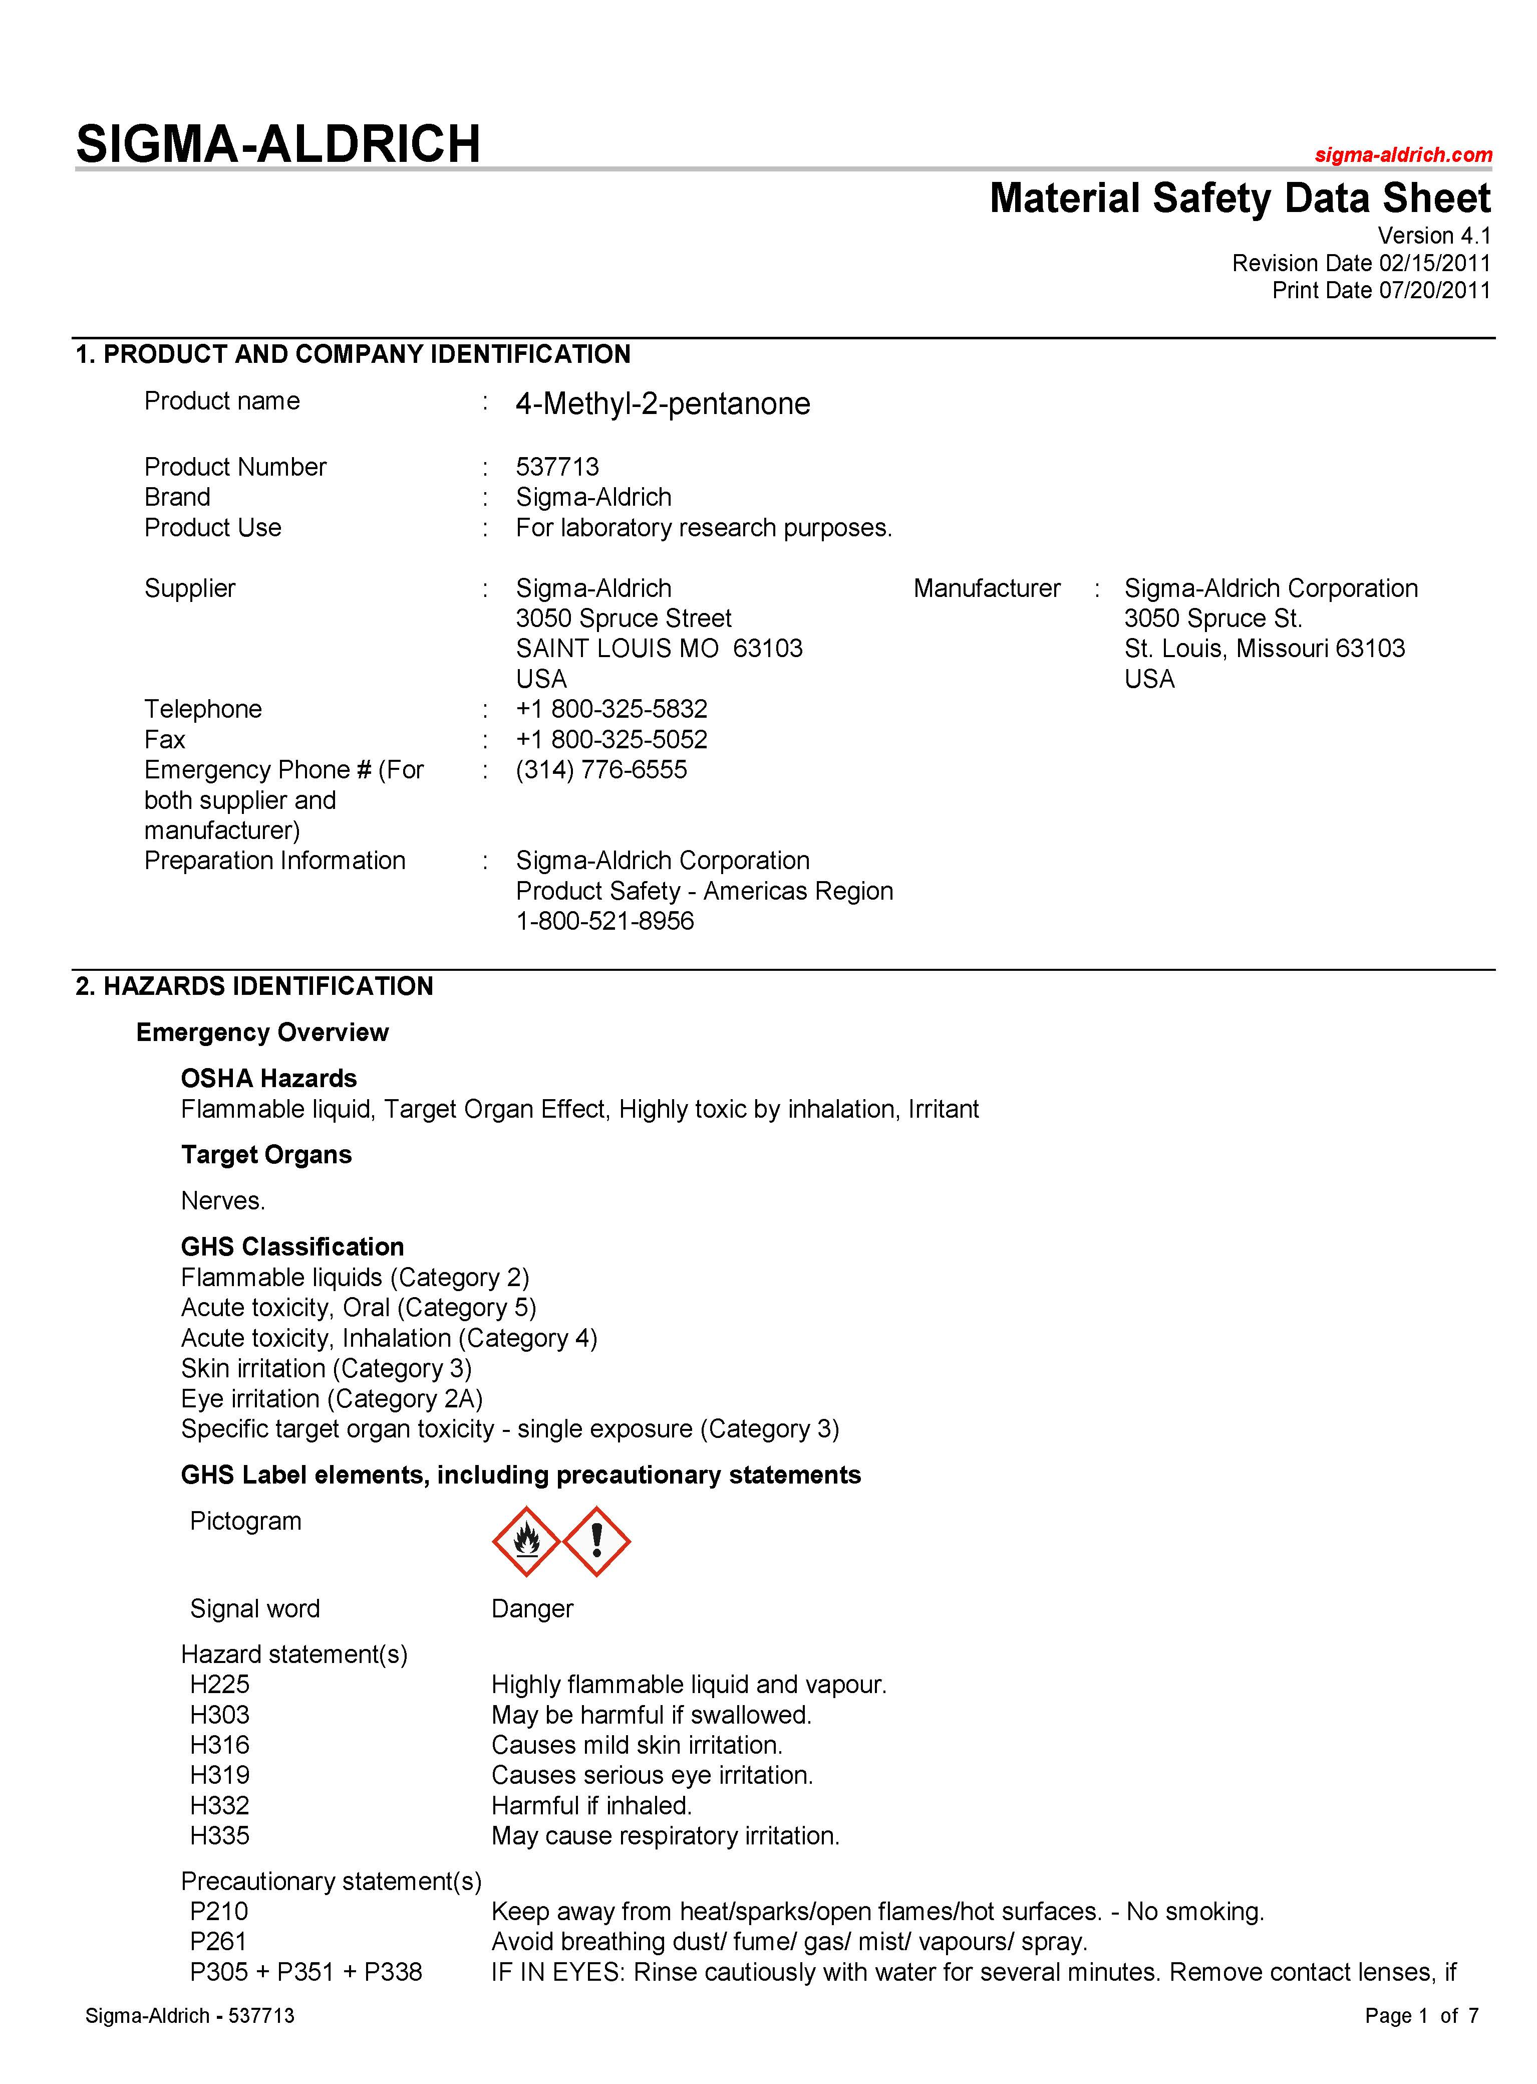
Section 1 – Identification
Includes product identifier; manufacturer or distributor name, address, phone number; emergency phone number; recommended use; any restrictions on use.

Slide 37
Section 2 – Hazard Identification
Includes all hazards regarding the chemical; required label elements.
In part, See SDS Sample PDF

Slide 38
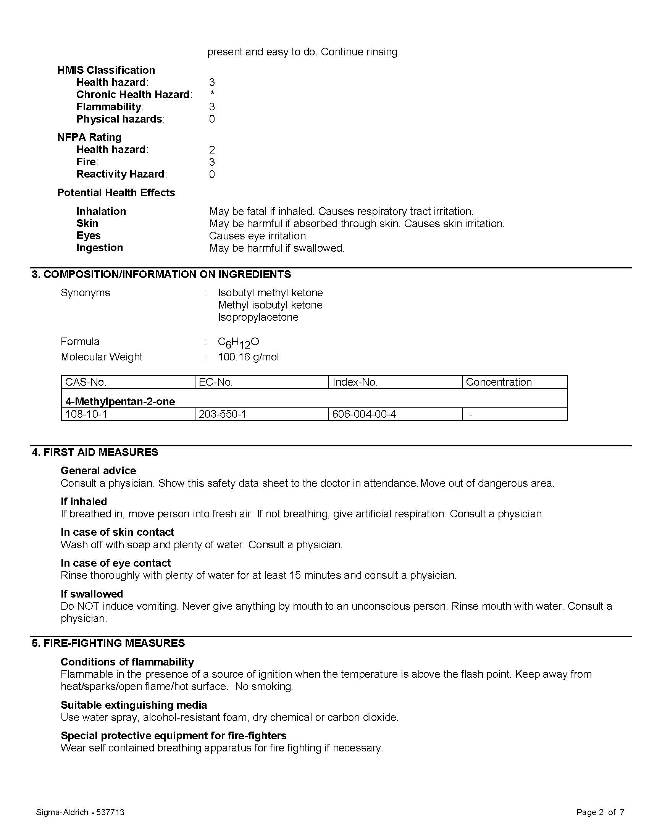
Section 3 – Composition
Composition/information on ingredients includes information on chemical ingredients; trade secret claims.

Slide 39
Section 4 – First Aid Measures
First-aid measures includes important symptoms/effects, acute, delayed; required treatment.

Slide 40
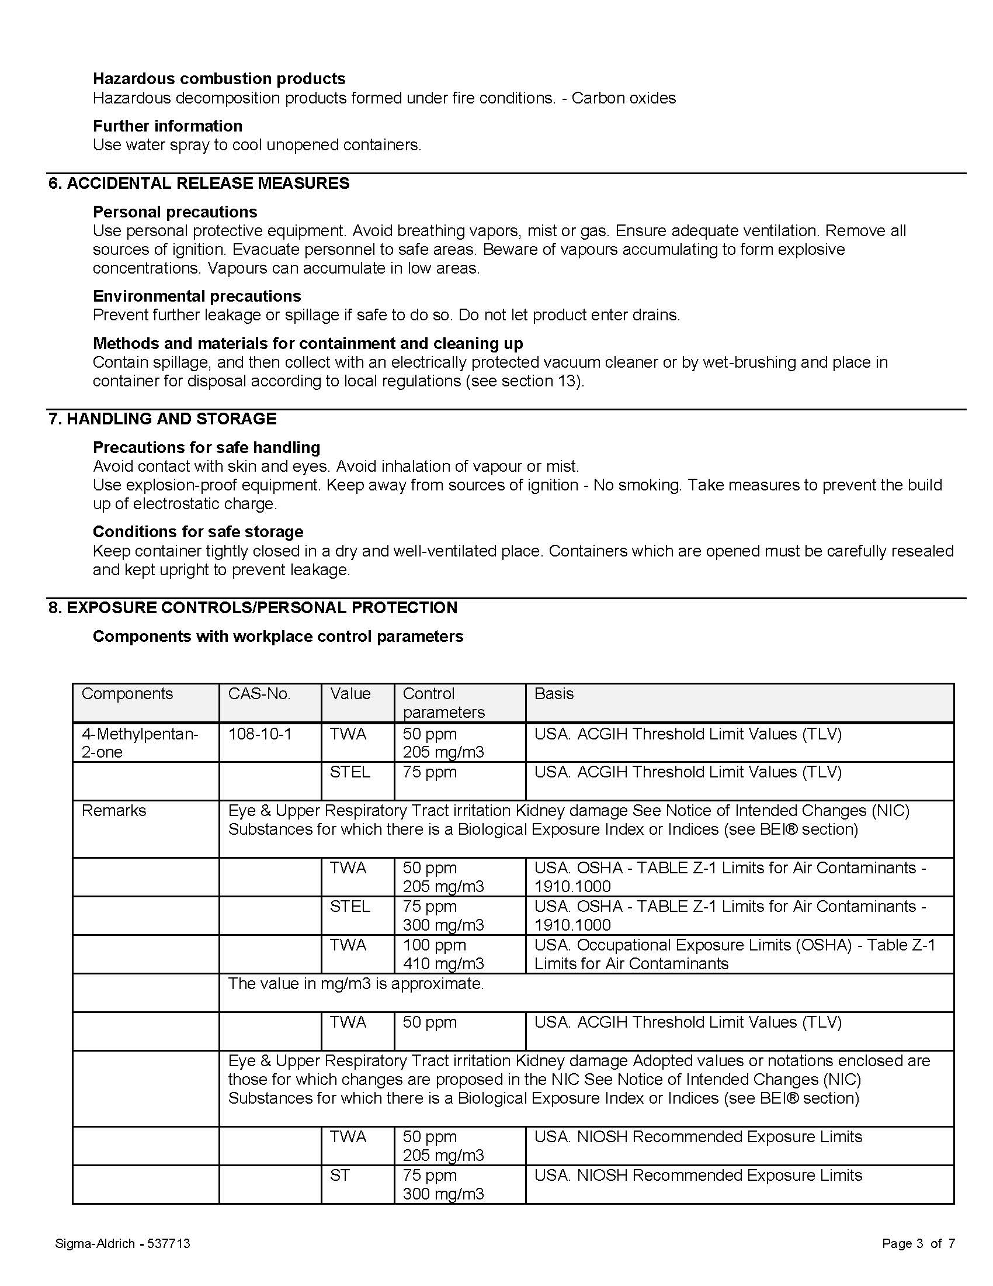
Section 5 – Fire-Fighting Measures
Fire-fighting measures lists suitable extinguishing techniques, equipment; chemical hazards from fire.

Slide 41
Section 6 – Accidental Release
Accidental release measures lists emergency procedures; protective equipment; proper methods of containment and cleanup.

Slide 42
Section 7 – Handling and Storage
Handling and storage lists precautions for safe handling and storage, including incompatibilities.

Slide 43
Section 8 – Exposure Controls PPE
Exposure controls/personal protection lists OSHA’s Permissible Exposure Limits (PELs); Threshold Limit Values (TLVs); appropriate engineering controls; personal protective equipment (PPE).
In part, See SDS Sample PDF

Slide 44
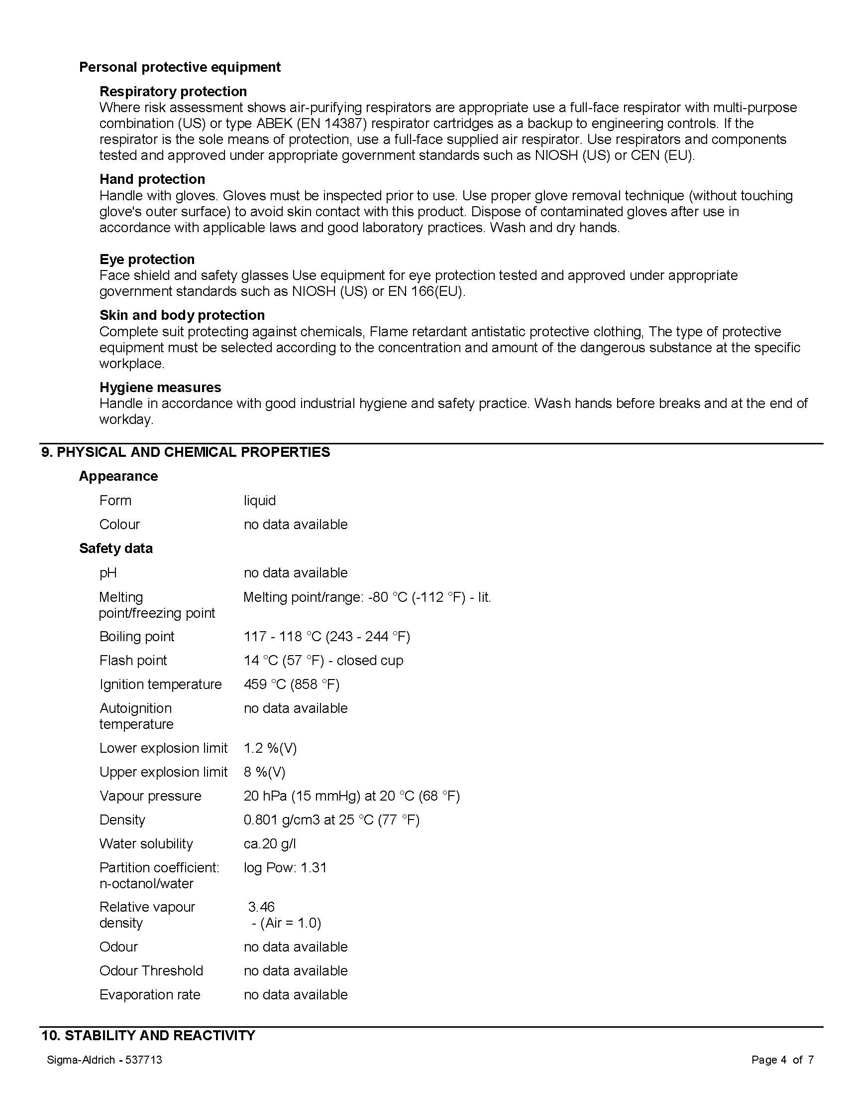
Section 9 – Chemical Characteristics
Physical and chemical properties lists the chemical’s characteristics. For example, how a chemical behaves in cold or heat.
In part, See SDS Sample PDF

Slide 45
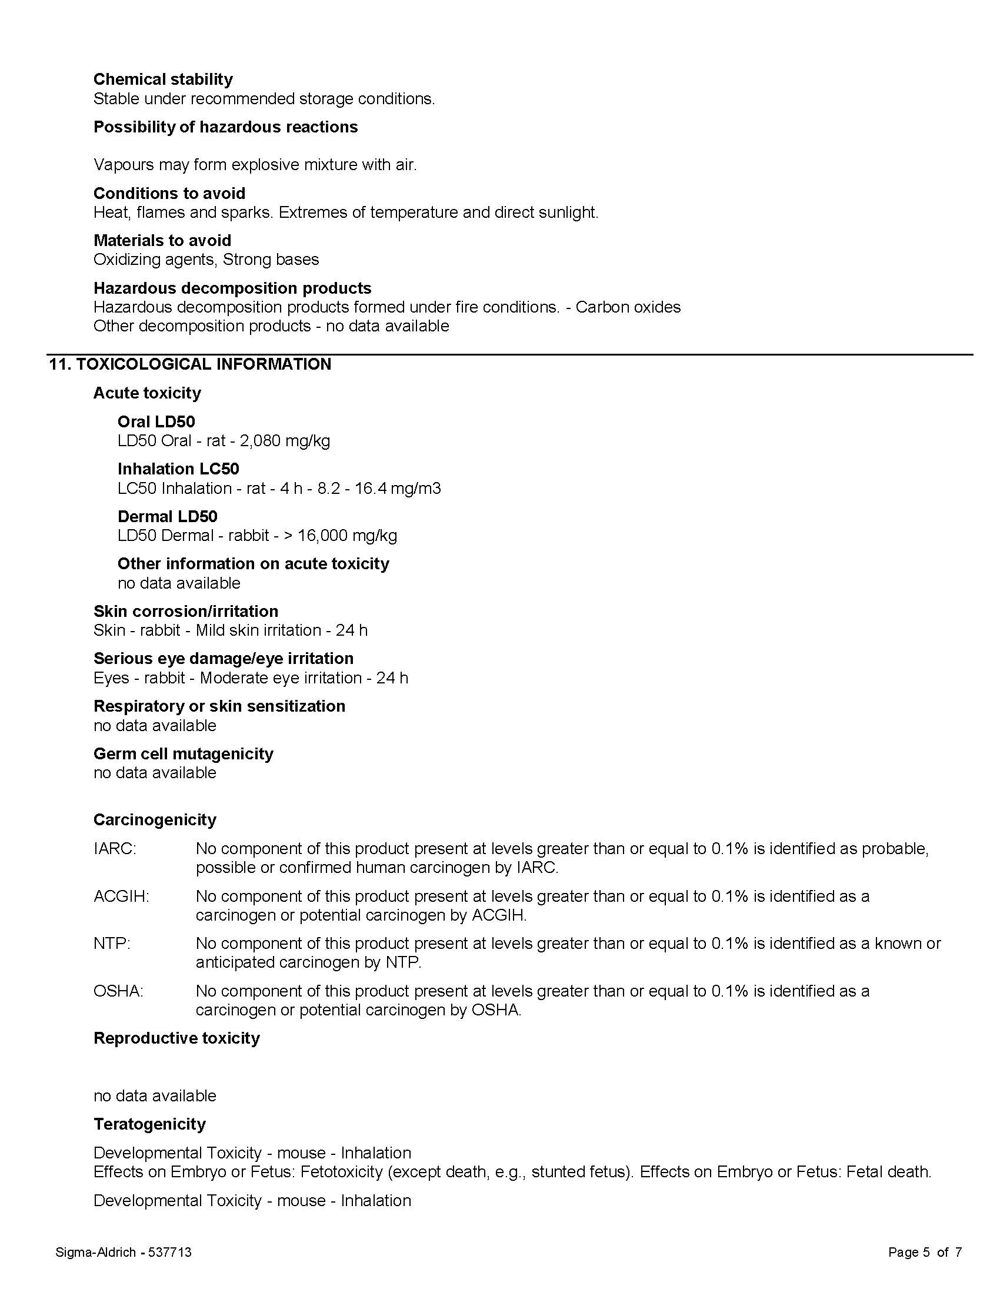
Section 10 – Chemical Stability
Stability and reactivity lists chemical stability and possibility of hazardous reactions. For example, how the chemical reacts to exposure to elements such as wetness, dampness or other chemicals.

Slide 46
Section 11 – Toxicology
Toxicological information includes routes of exposure; related symptoms, acute and chronic effects; numerical measures of toxicity.
In part, See SDS Sample PDF

Slide 47
Sections 12 through 15
OSHA does not enforce these requirements since they are regulated by other Agencies
        Section 12, Ecological information*
        Section 13, Disposal considerations*
        Section 14, Transport information*
        Section 15, Regulatory information*

Slide 48
Section 16 – Other Information
This section indicates when the SDS was prepared or when the last known revision was made.
The SDS may also state where the changes have been made to the previous version.
You may wish to contact the supplier for an explanation of the changes. Other useful information also may be included here.

Slide 49
Detailed Information
See Appendix D of 29 CFR 1910.1200 for a detailed description of required Safety Data Sheet contents.
Table D.1 provides the minimum information required for SDS.

Slide 50
Call to Action
Training of workers can begin immediately.
As new products are ordered, make sure to keep SDS documents in new formats.
Companies that manufacture products will have to conform to both employer and manufacturer provisions of revised rule.

Slide 51
Employer Responsibilities
Employers must ensure that the SDSs are readily accessible to employees for all hazardous chemicals in their workplace.
As an example, employers may keep the SDSs in a binder or on computers as long as the employees have immediate access to the information without leaving their work area when needed and a back-up is available for rapid access to the SDS in the case of a power outage or other emergency.

Slide 52
Employer Responsibilities (cont.)
In addition, employers may want to designate a person(s) responsible for obtaining and maintaining the SDSs.
If the employer does not have an SDS, the employer or designated person(s) should contact the manufacturer to obtain one.

Slide 53
Additional Resources
OSHA’s Hazard Communication website (http://www.osha.gov/dsg/hazcom/index.html) has the following QuickCards and OSHA Briefs to assist employers with the required training.
  Label QuickCard (English/Spanish)
  Pictogram QuickCard (English/Spanish)
  Safety Data Sheet QuickCard (English) (Spanish)
  Safety Data Sheet OSHA Brief
  Label/Pictogram OSHA Brief

Slide 54
Hazardous Comm. Standard
CFR 1910.200 Standard can be found on OSHA’s Hazard Communication Safety and Health Topics page, located at: http://www.osha.gov/dsg/hazcom/index.html
Hazard Communication Standard Facts
https://www.osha.gov/dsg/hazcom/HCSFactsheet.html

Slide 55
SDS Information
Safety Data Sheets and information are available at www.msds.com.
Several organizations can provide training programs either online or face-to-face programs.

Slide 56
Review Questions
1. What is the Globally Harmonized System?
A. The Globally Harmonized System (GHS) is an international approach to hazard communication, providing agreed criteria for classification of chemical hazards, and a standardized approach to label elements and safety data sheets.

Slide 57
Review Questions
2. Why did OSHA decide to modify the Hazard Communication Standard to adopt the GHS?
A. OSHA has modified the Hazard Communication Standard (HCS) to adopt the GHS to improve safety and health of workers through more effective communications on chemical hazards.

Slide 58
Review Questions
3. What is the phase-in period in the revised Hazard Communication Standard?
A. Dec. 1, 2013 Employees required to be trained on new safety label elements and new SDS formats
June 1, 2015* Compliance with all modified provisions of this final rule, except:
December 1, 2015 – The Distributor shall not ship containers labeled by the chemical manufacturer or importer unless it is a GHS label
June 1, 2016 – Update alternative workplace labeling and hazard communication program as necessary, and provide additional employee training for newly identified physical or health hazards.

Slide 59
Review Questions
4. Why must training be conducted prior to the compliance effective date?
A. OSHA is requiring that employees are trained on the new label elements (i.e., pictograms, hazard statements, precautionary statements, and signal words) and SDS format by December 1, 2013, while full compliance with the final rule will begin in 2015.

Slide 60
Review Questions
5. What are the major changes to the Hazard Communication Standard?
A. The three major areas of change are in hazard classification, labels, and safety data sheets.
Hazard classification: The definitions of hazard have been changed to provide specific criteria for classification of health and physical hazards, as well as classification of mixtures.
Labels: Chemical manufacturers and importers will be required to provide a label that includes a harmonized signal word, pictogram, and hazard statement, and precautionary statements for each hazard class and category.
Safety Data Sheets: Will now have a specified 16-section format.

Slide 61
Summary
There are new label requirements in the Hazardous Communication Standard – HCS
U.S. Implementation and Use of a Global Harmonization System – GHS
There is required training for employees relative to the new label elements.
There is new criteria for safety data sheets – SDS

Slide 62
Training Requirements for the new Hazardous Communications Standard
Michael J. Johnston
Executive Director Standards and Safety

