Slide 1
Apprenticeship Safety Discussion
National Electrical Contractors Association, International Brotherhood of Electrical Workers, and electrical training ALLIANCE
(NECA-IBEW-ETA)

Slide 2
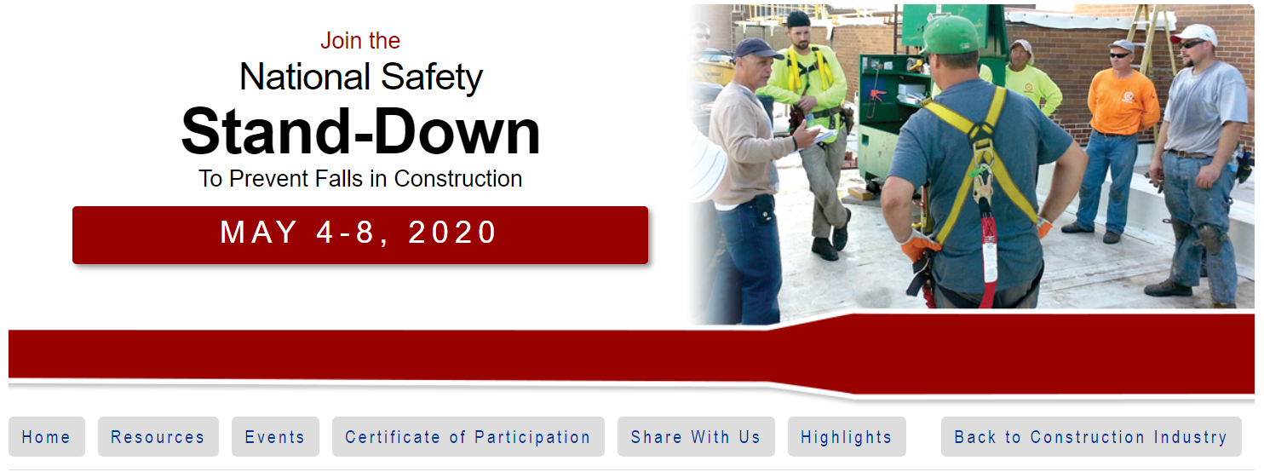

Slide 3
What is a Safety Stand-Down?
A Safety Stand-Down is a voluntary event for employers to talk directly to employees about safety.
Any workplace can hold a stand-down by taking a break to focus on "Fall Hazards" and reinforcing the importance of "Fall Prevention".
Employers of companies not exposed to fall hazards, can also use this opportunity to have a conversation with employees about the other job hazards they face, protective methods, and the company's safety policies and goals.
It can also be an opportunity for employees to talk to management about fall and other job hazards they see.

Slide 4
Why a Safety Stand-Down?
Fatalities caused by falls from elevation continue to be a leading cause of death for construction employees, accounting for 320 of the 1,008 construction fatalities recorded in 2018 (BLS data).
Those deaths were preventable.
The National Safety Stand-Down raises fall hazard awareness across the country in an effort to stop fall fatalities and injuries.

Slide 5
Who Can Participate?
Anyone who wants to prevent hazards in the workplace can participate in the Stand-Down.
In past years, participants included:
Commercial construction companies of all sizes, residential construction contractors, sub- and independent contractors,
Highway construction companies, general industry employers, the U.S. Military, other government participants, unions,
Employer's trade associations, institutes, employee interest organizations, and safety equipment manufacturers.

Slide 6
For More Safety Stand-Down Information…
https://www.osha.gov/StopFallsStandDown/
Certificate of Participation
Employers will be able to provide feedback about their Stand-Down and download a Certificate of Participation following the Stand-Down. The certificate pages will be active on May 4, 2020, for employers to enter their information and print their certificate.
Share Your Story With Us
If you want to share information with OSHA on your Safety Stand-Down, Fall Prevention Programs or suggestions on how we can improve future initiatives like this, please send your email to oshastanddown@dol.gov. Also share your Stand-Down story on social media, with the hashtag: #StandDown4Safety.

Slide 7
A Number of Considerations Incorporating OSHA and NFPA 70E
Safety Message

Slide 8
Only Qualified Persons Can Work Energized
Some of the things that must be considered to determine if “performing energized work” is justified and in compliance with OSHA and/or NFPA 70E Standard.
Only qualified persons can perform energized work.
The “energized work” must be justified in accordance with OSHA and NFPA 70E rules.
The worker must be a “qualified person” in accordance with OSHA and NFPA 70E.

Slide 9
Only Qualified Persons Can Work Energized
The 70E training to become a “qualified person” is documented by the contractor (employer) when proficiency is demonstrated.
A shock and arc flash risk assessment has been completed and is used by the qualified person when application of the Hierarchy of Risk Control Methods has determined that the additional protective measures includes the use of PPE.

Slide 10
Hierarchy of Risk Control Methods
The risk assessment procedure shall require that preventive and protective risk control methods be implemented in accordance with the following hierarchy:
(1) Elimination
(2) Substitution
(3) Engineering controls
(4) Awareness
(5) Administrative controls
(6) PPE

Slide 11
Non-mandatory Examples of Hierarchy of Risk Control Methods from NFPA 70E Informative Annex F

Slide 12
Only Qualified Persons Can Work Energized
Again, only qualified persons can work on electrical equipment that is not in an electrically safe work condition
Personal Protective Equipment (such as rubber insulating gloves and leather protectors, arc-rated garments and arc-rated face shields) and Other Protective Equipment (such as insulated tools) have been provided by the contractor (employer).
The contractor (employer) has documented that the employee has demonstrated proficiency in selecting an appropriate test instrument, how to use it to verify the absence of voltage and understands all limitations of each test instrument.

Slide 13
Only Qualified Persons Can Work Energized
The test equipment used (such as a voltage tester), has an adequate rating (such as voltage and category rating).
Performing energized work includes performing tasks such as testing, troubleshooting, and voltage measuring on electrical equipment operating at voltages equal to or greater than 50 volts.
Conductors and parts of electrical equipment that have been deenergized but have not been locked out and tagged must be treated as energized parts.

Slide 14
Only Qualified Persons Can Work Energized
It is essential that all involved always strive to eliminate the hazard and establish an electrically safe work condition as the first choice.
Use of Personal Protective Equipment is the last in the hierarchy of risk control methods when justified energized work must be performed by a qualified (trained) person. Consult NFPA 70E in its entirety.

Slide 15
Time-Out for Safety
Stop-Work Authority
Continuing Education Module
1st Quarter 2017
Notes:
Opening discussion: Did you know that sometimes the most important thing you can do is to STOP working? If you’re working and you see a process that is not being followed correctly, or if you notice at-risk behavior going on, take the initiative and call a quick time-out. Then confer with your workmates to make sure everyone knows the safe way to continue. Executing Stop Work Authority to right safety wrongs and catch potential unsafe action before it actually happens is not only responsible, it’s also effective. In fact, in the oil and gas industry, it’s been one of the most successful approaches to safety in the last decade. Empower the people around you. Encourage them to watch for unsafe conditions or processes, and when it’s necessary, stop the job until it can be done safely.

Slide 16
Our Commitment
Your personal safety is very important
To the Company
Your family
Your loved ones
Notes:
Explain that personal safety to our workforce is very important to our company, family and loved ones.

Slide 17
We Encourage You
Ask questions regarding safety
Never perform any task you feel is unsafe
Never perform any task you are not qualified to perform
All work can and must be performed safely!
Notes:
Explain that we encourage you (workers) to ask questions regarding safety and never perform any task you feel is unsafe or that you are unqualified to perform. All work can and must be performed safely!

Slide 18
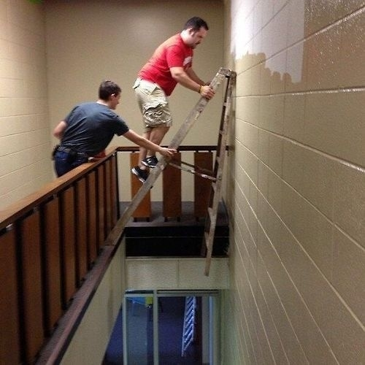
Reporting Unsafe Conditions
Report any unsafe activity or condition
Notification should be made to the supervisor or designee
Why women live longer than men
Notes:
Explain that we want and expect workers to report any activity or condition which he/she believes is unsafe. Notification should be made to the supervisor or designee at the location where the activity or condition exists. Following notification, the responsible supervisor or management designee will resolve this issue.

Slide 19
Stop-Work Responsibility
Every employee has the responsibility and authority to stop work immediately Without fear of reprisal
Notes:
Explain that every employee has the responsibility and authority to stop work immediately, without fear of reprisal, when the employee believes conditions exist that pose a danger to the health and safety of workers or the public; or conditions exist, that if allowed to continue, could adversely affect the safe operation of, or could cause serious damage to, a facility; or conditions exist, that if allowed to continue, could result in the release of hazardous substances that could exceed applicable regulatory requirements or approvals.

Slide 20
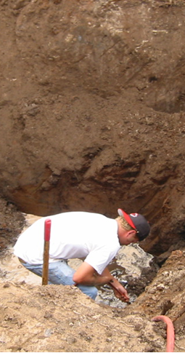
Expectation
Any employee who reasonably believes that an activity or condition is unsafe is expected to:
Stop or refuse work without fear of reprisal by management or coworkers
And is entitled to have the safety concern addressed prior to participating in the work.
Notes:
Any employee who reasonably believes that an activity or condition is unsafe is expected to stop or refuse work without fear of reprisal by management or coworkers and is entitled to have the safety concern addressed prior to participating in the work.

Slide 21
Resolution
If an employee or supervisor has a stop work issue that has not been resolved through established channels
Immediately contact the safety manager, upper management or employee representative
Notes:
If an employee or supervisor has a stop work issue that has not been resolved through established channels, immediately contact the safety manager, upper management or employee representative.

Slide 22
Review
Never perform work that you feel is unsafe or that you do not feel qualified to perform
Each employee has the right and obligation to call a halt to any unsafe work activity
Each employee has the right to stop or refuse work without fear of reprisal by management or coworkers
If an employee has a stop work issue that is not resolved through established channels they must immediately contact the safety manager, upper management or employee representative
Notes:
Review.

Slide 23
Injury Free Takes You and Me!
Target
Safety
Notes:
Review.

Slide 24
Safety leader is defined as…
A person who has the courage to demonstrate that s/he values safety by working and communicating with team members to identify and limit hazardous situations even in the presence of other job pressures such as scheduling and costs.
Notes:
ASK CLASS:
HOW WOULD YOU DEFINE A SAFETY LEADER?
In the FSL course, we define a safety leader as... A person who has the courage to demonstrate that s/he values safety by working and communicating with team members to identify and limit hazardous situations even in the presence of other job pressures such as scheduling and costs.
ASK CLASS:
WHAT DO YOU THINK ABOUT THE WORD COURAGE? DOES IT TAKE COURAGE TO BE A LEADER? DOES THE AMOUNT OF COURAGE DEPEND ON YOUR ROLE OR POSITION ON THE JOBSITE? WHEN A COMPANY VALUES SAFETY AND IT’S NOT JUST A PRIORITY, HOW MIGHT THAT AFFECT THE NEED FOR COURAGE?

Slide 25
Who are Safety Leaders?
Foremen
Experienced workers
Trainees/apprentices
Superintendents
Owners
Anyone….Everyone
Notes:
ASK CLASS:
WHO ARE THE SAFETY LEADERS ON A JOBSITE?
Anyone, regardless of their title or role, who values their safety and well-being and that of their fellow workers, is responsible for being an effective safety leader. This means that everyone needs to develop and use safety leadership skills.

Slide 26
Direct Costs
Medical treatment
Lost wages
Sick pay
Damage to product or equipment
Higher insurance premiums
Notes:
It’s been shown that over the course of their career, a construction worker has a 78% chance of getting injured at work.
The total cost of these injuries to workers, contractors, and the construction industry as a whole is over $11 billion per year or about $27,000 per injured construction worker.
There are costs which are easier to see called Direct Costs, and others which may not be so obvious, called Indirect Costs. Leadership can play a part in whether or not a company experiences these costs.
ASK CLASS:
WHAT DO YOU THINK ARE EXAMPLES OF DIRECT COSTS OF JOBSITE INJURIES?
Direct costs include medical treatment, lost wages, sick pay, damage to work product or equipment, and increased insurance premiums.

Slide 27
Indirect Costs
Disability
Shorter life expectancy
Family and co-worker suffering
Lost productivity
Hiring costs
Diminished company reputation
Death
Notes:
ASK CLASS:
WHAT ARE SOME EXAMPLES OF INDIRECT COSTS?
Indirect costs include things like family and co-worker suffering, lost productivity related to incident investigations and work stoppage, hiring costs to replace an injured worker, and the company’s diminished public reputation, especially if the incident is covered by local media. This can reduce the company’s ability to win bids.
ASK CLASS:
ARE SOME OF THESE COSTS MORE IMPORTANT THAN OTHERS?

Slide 28
Benefits of Effective Safety Leadership
Increased morale
Increased teamwork
Positive safety climate
Reduced hazards
Safer work practices
Fewer injuries and fatalities
Better business reputation
More productive and better quality
Others?
Notes:
ASK CLASS:
SO, TO SUMMARIZE, TELL ME WHAT YOU THINK SOME OF THE BENEFITS ARE OF BEING AN EFFECTIVE SAFETY LEADER ON A JOBSITE?
(After you make a list on the board, present the slide list and if there’s time, tie this back to costs from slide 9 and 10)
-----------------------
We’ve gone over the costs of ineffective safety leadership and benefits of effective leadership and how good leadership can improve safety climate and safety outcomes. But we actually haven’t defined what a safety leader is or what skills she or he can use on the jobsite. That’s what we’re going to cover next before we get into the scenarios.

Slide 29
5 LEADERship Skills
Leads by example
Engages and empowers team members
Actively listens and practices three-way communication
DEvelops team members through teaching, coaching, & feedback
Recognizes team members for a job well done
Notes:
The FSL course focuses on 5 critical skills that you as a safety leader can use to create a strong jobsite safety climate and reduce safety incidents.
Here they are…
DISTRIBUTE WALLET CARD WITH SKILLS AND TELL CLASS:
These wallet cards list the skills.
I’d encourage you to put it in your wallet and look at it every so often to refresh your memory of what you learned today.
Next, we are going to discuss the specific actions you can use to demonstrate each of these on the jobsite.

Slide 30
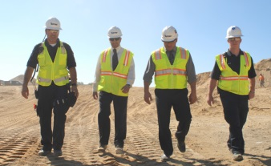
How to Lead by Example
Have a positive attitude about safety
Establish safety as a core value
Set high expectations for safety
Share safety vision with the team
“Walk the talk”
Reinforce the idea that everyone owns safety
Lead up!
Notes:
Leading by example is probably the most important of the five safety leadership skills in the FSL course.
ASK CLASS: WHAT DO YOU THINK IT MEANS TO LEAD BY EXAMPLE?
Team members learn from their leaders. They notice when they cut corners, don’t follow safety policies or procedures, or give inconsistent safety messages.
ASK CLASS: HOW DOES COURAGE PLAY INTO LEADING BY EXAMPLE?
Let’s go over some ways you can lead by example.
First, you need to personally value and consistently demonstrate a positive attitude about safety. You should also establish safety as the team’s core value by building it into all aspects of the job.
As a safety leader you must set high safety expectations for every team member. Let them know on a regular basis that you expect them to always use safe work practices and ensure that other team members do too, and immediately report hazardous conditions and all injuries or near misses.
These actions send the message that safety is an integral part of working everyday and not just a way to avoid safety violations. The next way to lead by example is to develop and share your safety vision with your team.
ASK CLASS: WHAT DO YOU THINK IT MEANS TO HAVE A SAFETY VISION?
You can talk about the importance of safety for you and for them in terms of the direct and indirect costs we talked about. You can emphasize that safe work goes hand-in-hand with productive and quality work. Another part of creating a vision is to consider the safety implications of all your decisions and share those with your team.
An action you can put into place immediately is to not practice the old way of “Do as I say, but not as I Do,” and instead, “Walk the talk” by always following safe work procedures and practicing safe practices.
As a leader, you need to consistently communicate that everyone owns safety. It’s not just the foreman’s or safety person’s responsibility. It’s up to everyone to keep the jobsite safe for themselves and others. A final way to lead by example …
is to lead up by working to persuade individuals like company owners and others in supervisory positions to improve jobsite safety and health.
ASK CLASS: HOW DOES COURAGE PLAY INTO LEADING UP?
Some ideas for things you can do to lead up include:
• Find out what has (and hasn’t) worked in the past to motivate them to improve safety and health policies
• Try to get them to think about safety in a new way
• Present solutions, rather than only pointing out problems
• Find others (workers, foremen, etc.) to help you convey your message

Slide 31
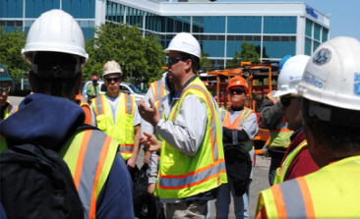
How to Engage and Empower Team Members
Explain why safety is critical to getting the job done
Engage team members in safety decision-making
Conduct daily morning safety huddles and joint worker-management walk-arounds throughout the workday
Empower team members to
Report safety concerns, injuries and near misses
Report or fix hazards or unsafe situations
Notes:
The next leadership skill is to engage and empower team members in the safety process.
ASK CLASS:
WHAT ARE SOME IDEAS FOR DOING THAT?
You can explain why working safely is critical to getting the job done and not just say “be safe”.
You can engage the team in safety-related decisions so they can see how they, too, own safety. These skills can be used with the whole group as well as with individual workers.
Involving workers in daily huddles and joint management walk-arounds lets the team know that safety is valued, it is an essential aspect of how work gets done, and they are a critical part of the overall safety effort.
Finally, as a leader, you need to empower team members to report jobsite hazards, safety concerns, and near misses, and to act upon unsafe situations and make it clear that there will be no negative consequences or retaliation when they do. You can develop an “action list” to show how issues raised are addressed and place the list in a prominent place to help ensure accountability and build trust.

Slide 32
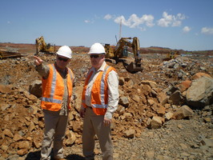
How to Actively listen and Practice 3-way Communication
Treat team members with respect when they are speaking
Pay attention to non-verbal cues such as body language and eye contact
Listen to hear what is being said vs. to come up with a response.
Ask clarifying questions
Actively listen
Notes:
Being able to communicate effectively is at the core of all the other leadership skills and is critical to becoming an effective safety leader.
There are 2 aspects to this skill. The first one we’ll discuss is about learning to be an Active rather than Passive listener. The second one outlines a simple strategy you can use to reduce misunderstandings between you and the person you’re speaking with.
ASK CLASS:
HAVE YOU EVER TRIED TELLING SOMEONE SOMETHING IMPORTANT AND YOU CAN TELL THEY AREN’T LISTENING? HOW CAN YOU TELL?
Learning to actively listen first involves treating your team member with respect and giving that person your full attention. Don’t check phones, emails, or read other materials during the conversation. Pay special attention to your and the speaker’s body language because it can sometimes convey more information than words. Maintain eye contact; avoid making negative facial expressions or raising your voice. If you’re feeling resentful or insulted, make an extra effort to maintain professional conduct.
Most importantly, you need to listen to hear what the person is saying rather than listening just to come up with a response. Finally, ask clarifying questions to ensure you understand what speaker is saying or asking.

Slide 33
How to Actively Listen and Practice 3-way Communication (cont’d)
Practice 3-way
communication
Make sure you have listener’s attention
Be direct and concise
Ask team member to repeat message
Clarify any misunderstandings
Notes:
ASK CLASS:
HAVE YOU EVER GIVEN SOMEONE INSTRUCTIONS TO DO SOMETHING, THEY SAY SURE THING, AND THEN GO AND DO SOMETHING ELSE? COULD IT BE THAT THEY DIDN’T UNDERSTAND WHAT YOU WERE ASKING THEM TO DO?
Practicing 3-way communication helps ensure everyone understands your message or instructions. This is done by making sure you have the listener’s attention, being direct and concise, and most importantly, having the listener repeat what you said to be sure the message was understood. This also allows you to clarify any misunderstandings.
CLASS ACTIVITY:
PRACTICE 3-WAY COMMUNICATION WITH SOMEONE IN THE CLASS – OR ASK STUDENT TO DO IT
Example: “Hey [student’s name], can you go get me a sandwich?” After the student responds, comment that they did not get you the right kind of sandwich and they didn’t get you a chips or a drink, either!

Slide 34
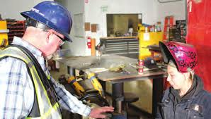
How To Develop Team Members through Teaching, Coaching, and Feedback
Observe worker action
Address the issue
Problem solve
Practice action
Teach & coach
Notes:
Effective safety leaders work to develop their team members by teaching and coaching them on how to do things correctly and safely on the jobsite. They also provide feedback to let them know how they are doing and if any changes are needed.
ASK CLASS:
WHAT IS THE DIFFERENCE BETWEEN TEACHING, COACHING, AND FEEDBACK?
Teaching = telling
Coaching = watching
Feedback = evaluating performance
First, we’ll talk about teaching and coaching.
When you want to teach a team member a new or better way to do something, respectfully ask questions to understand why s/he is doing it that way and then problem-solve together (even if you already have a solution) to find a better or safer approach to completing the task.
Show the team member how to perform the activity correctly, then watch him/her to be sure they have learned how to do it. If they need to be corrected, treat the person with respect and be a coach.
Encourage team members to constantly update their knowledge and skills so they can do their jobs better and safer.

Slide 35
How To Develop Team Members through Teaching, Coaching, and Feedback
Use the FIST Principle:
Describe the FACTS
Explain the IMPACT
Provide SUGGESTIONS
Be TIMELY
Notes:
Providing constructive feedback is another leadership skill you can use to develop your team members.
When giving constructive feedback, try hard to focus on the situation or behavior rather than the person.
The FIST principle can help you do that.
First, describe the Facts: What is the situation or activity/behavior for which you are providing feedback? When and where did it occur? What were the circumstances?
Next, explain the Impact: What are the potential consequences that may result (good or bad)?
Then, offer Suggestions: Work together to problem-solve and come up with solutions. Think of ways team members might use the same approach in the future.
Finally, be Timely: Don’t wait to provide feedback. It is more effective when you give it close to when the situation/behavior occurred.
CLASS ACTIVITY:
PRACTICE THE FIST PRINCIPLE
FOR EXAMPLE, USE THE FIST PRINCIPLE TO GIVE A TEAM MEMBER CONSTRUCTIVE FEEDBACK ABOUT ALWAYS BEING LATE TO WORK.

Slide 36
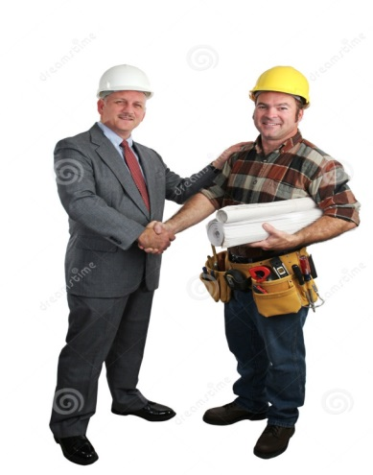
How to Recognize Team Members for a Job Well Done
Give recognition separately from other types of feedback
Regularly give praise in private
Be specific about why you are praising the person
Give praise publically if the person is comfortable with it
Notes:
The final skill effective safety leaders display is to recognize team members when they go above and beyond to maintain a strong positive jobsite safety climate.
ASK CLASS:
WHY IS IT IMPORTANT TO DO THIS? (e.g. Appreciation motivates and encourages team members to continue working to maintain and improve the jobsite safety climate)
Like other types of feedback, recognition should be given in a timely manner and it must be sincere. It’s also important to separate this type of “way to go” or praise feedback from the type of feedback we just discussed. It may be as simple as saying “good job,” giving a hand shake, or saying “thank you” for going the extra mile for safety or for something really well done.
It’s important to know your team members as individuals so you can use praise and acknowledgement effectively. For those who are comfortable with public praise, it is a great way to show others that safety is valued. However, a person uncomfortable with public praise may be more embarrassed rather than pleased.
ASK CLASS:
WHAT ARE SOME THINGS YOU MIGHT WANT TO CONSIDER WHEN GIVING PRAISE? (Generational differences - millennials – always needing praise; Old days = no news is good news; Personality of individual; Jobsite culture or climate)
IS THERE EVER A DOWNSIDE TO GIVING RECOGNITION? (Coworker reaction, perceived favoritism, preferential treatment)
----------------------------------------
So we’ve covered the costs of ineffective safety leadership, the benefits and importance of effective safety leadership, and presented the five safety leadership skills covered in this course. Next we’re going to work through some real-world construction scenarios to see how the skills are or are not applied on the jobsite.
Before we start that though, as we go through the scenarios I want you to keep in mind that practicing and using these skills is really not very time-consuming. And that they can be easily inserted into daily workflow and are likely to improve productivity.

Slide 37
The Following is from the Effective Leadership Skills Course
This Leadership course was developed for the electrical training ALLIANCE (etA) by American Technical Publishers (ATP)
Textbook is available from the etA
Blended Learning course, including PowerPoint, is in etA’s Learning Management System (LMS)
This, like all content, should be covered in its entirety
Notes:
- The fact that a person has been asked to be a field leader recognizes years of hard work and means that the individual is viewed to have leadership potential. However, going from being a reliable crew member to being a person who is constantly in charge is not an easy shift to make.
- A new field leader must move away from thinking only of the actions required for an individual to be productive on the job to anticipating the needs of all the people involved in a project from start to finish.
- The role of a field leader comes with new responsibilities and added stress. An attitude of constant anticipation becomes the new norm.
- A field leader must work hard every day and face many challenges. Along with the many years of experience required, there are eight key leadership qualities that enable a field leader to be successful.
- Effective field leaders consistently practice professionalism and respect, have proven credibility and character, exhibit ethics and integrity, and teach future leaders as well as learn from others.

Slide 38
Chapter 2 Leadership Qualities
Section 2.1 Professionalism and Respect
Objectives:
Describe how professionalism is demonstrated by effective field leaders.
Explain why effective field leaders need to respect crew members, field leaders of other trades, and members of the construction management team.
Notes:
- The fact that a person has been asked to be a field leader recognizes years of hard work and means that the individual is viewed to have leadership potential. However, going from being a reliable crew member to being a person who is constantly in charge is not an easy shift to make.
- A new field leader must move away from thinking only of the actions required for an individual to be productive on the job to anticipating the needs of all the people involved in a project from start to finish.
- The role of a field leader comes with new responsibilities and added stress. An attitude of constant anticipation becomes the new norm.
- A field leader must work hard every day and face many challenges. Along with the many years of experience required, there are eight key leadership qualities that enable a field leader to be successful.
- Effective field leaders consistently practice professionalism and respect, have proven credibility and character, exhibit ethics and integrity, and teach future leaders as well as learn from others.

Slide 39
Section 2.1 — Professionalism and Respect
“Professionalism requires being courteous, honest, and responsible when dealing with individuals or companies.”
Notes:
- Professionalism requires being courteous, honest, and responsible when dealing with individuals or companies.
- Effective field leaders are always professional in their interactions with crew members, with field leaders from other trades, and with members of the construction management team.

Slide 40
Section 2.1 — Professionalism and Respect
In a competitive marketplace where multiple companies provide the same services for around the same price, the level of professionalism exhibited can tip the scale.
Notes:
In a competitive marketplace where multiple companies provide the same services for around the same price, the level of professionalism exhibited can tip the scale.
- Many opportunities are missed because a potential customer has a less-than-positive perception of how projects are being managed.
- An effective field leader sets a professional example by giving customers the opportunity to see a job site that is a cut above the rest.
- Sprucing up a job site for an important visitor is not the way to go about it. Rather, it is about having pride in the organization of the job site and making sure that it runs efficiently.
- Staying organized also lessens the stress levels of everyone involved.

Slide 41
Additional Discussion on Company Safety Policies

Slide 42
Thank you for Your Continued Commitment to Safety
What is More Important Than Your Safety?
Everyone is a safety leader
You have the right and responsibility to speak up
Remember that “justified energized work” is only permitted to be performed by qualified persons

