Slide 1
Academy Paper

Slide 2
Fifty Years of the
Academy of Electrical
Contracting
J Michael Thompson (’92)

Slide 3
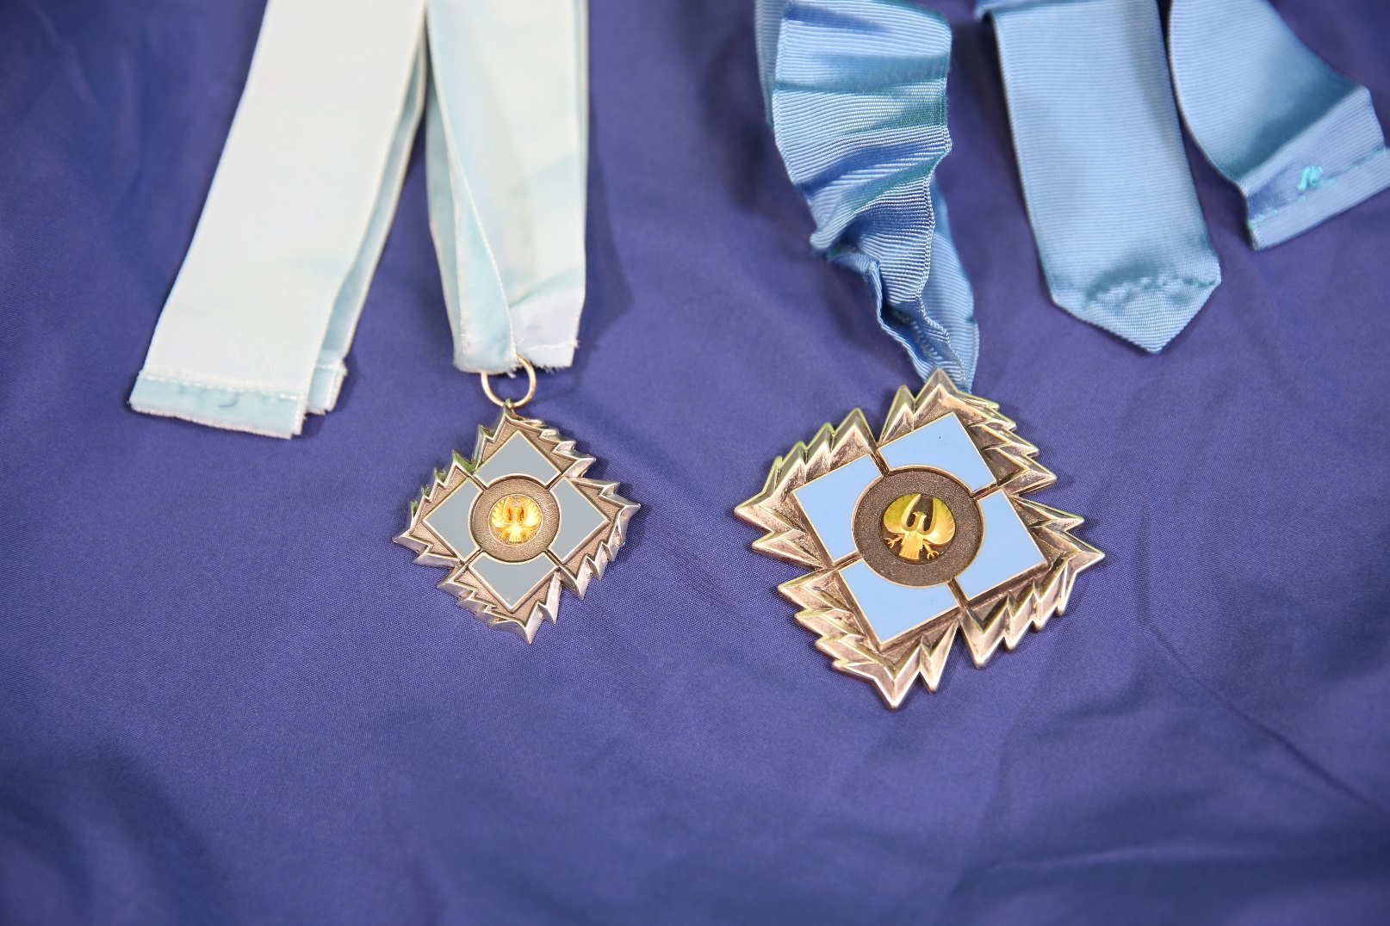
6.3 oz
1.9 oz

Slide 4
Think About It:
Academy of Electrical Contractors
OR
Academy of Electrical Contracting

Slide 5
The Answer Is:
Academy of Electrical Contracting

Slide 6
Sites of Academy Meetings

Slide 7
Sites of Academy Meetings
1
1
1
1
1
1
1
1

Slide 8
Sites of Academy Meetings
1
1
2
1
1
1
1
2
1
2
2
1

Slide 9
Sites of Academy Meetings
1
1
2
1
1
1
1
6
2
1
2
2
1
6

Slide 10
Sites of Academy Meetings
1
1
2
1
1
1
1
6
7
2
1
2
2
1
6

Slide 11
Sites of Academy Meetings
1
1
2
1
1
1
1
6
7
2
12
1
2
2
1
6

Slide 12
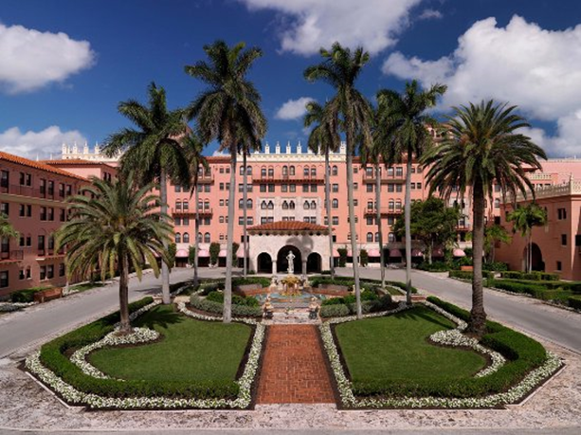
Boca Raton
1976, 1981, 1985 & 1990

Slide 13
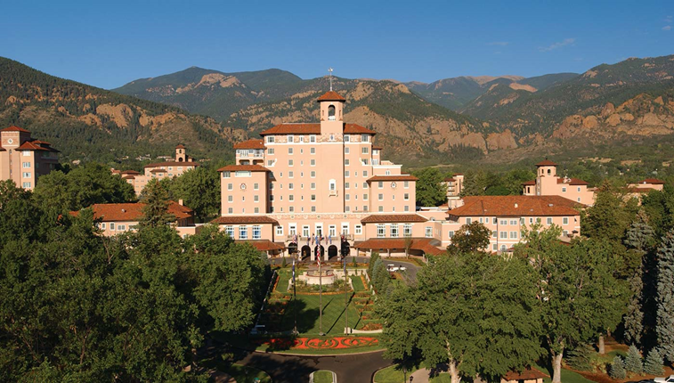
The Broadmoor
1970, 1972, 1974, 1991 & 2012

Slide 14
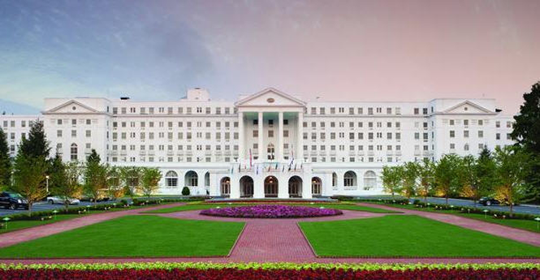
The Greenbrier
1969, 1973, 1979, 1983, 1987, 1994 & 2011

Slide 15


Slide 16
“Oldest” Fellows
Walter Parkes (‘91)
Bob Dixon (‘91)
Dick McBride (‘90)
Rod Borden (‘88)
John Grau (‘86)
Fred Sargent (‘81)

Slide 17
Special Thanks to:
Robert L Higgins (’68)
John M Grau (‘86)

