Slide 1
The Academy of Electrical Contracting
Paper Presented by Fellow
Franklin P. Holleran (‘15)

Slide 2
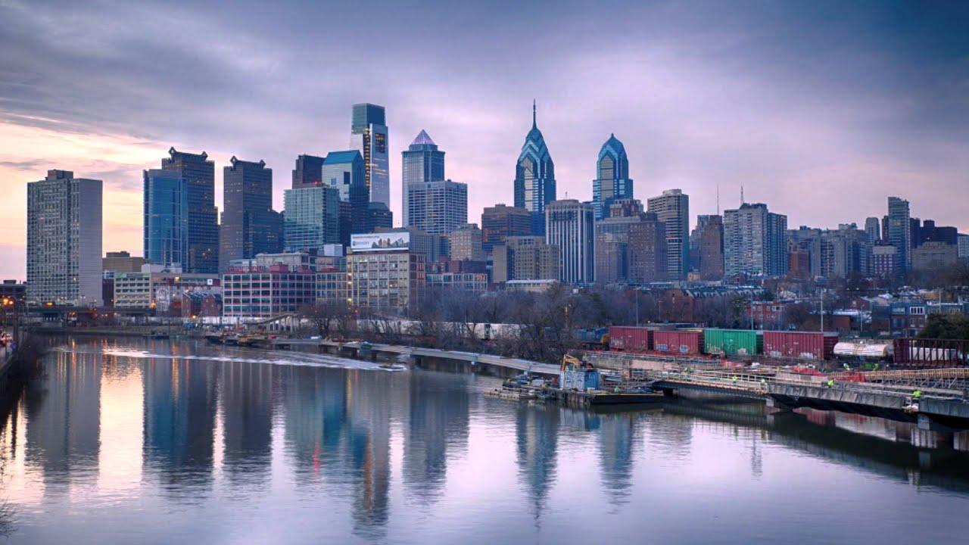
Philadelphia Skyline

Slide 3
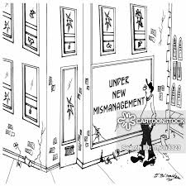
Construction Mismanagement!

Slide 4
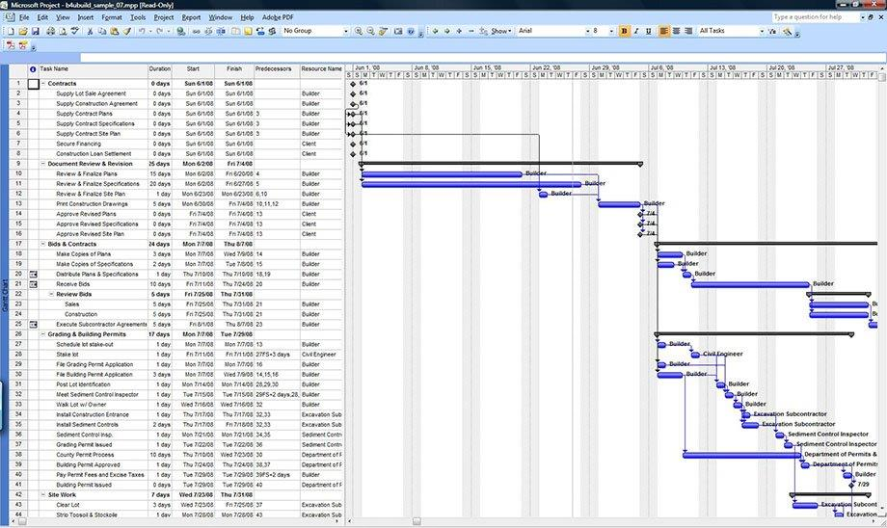
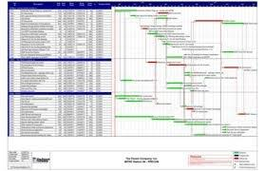
CM Pre Construction Schedule

Slide 5
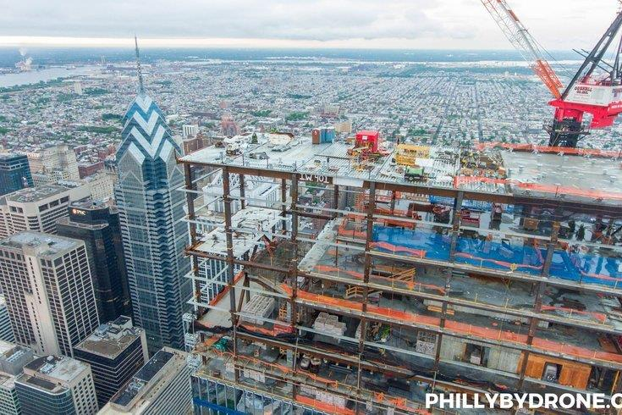
Construction in Philadelphia
https://media.phillyvoice.com/media/images/NEWphillybydrone-comcast-technolog.0d1df232.fill-735x490.jpg

Slide 6
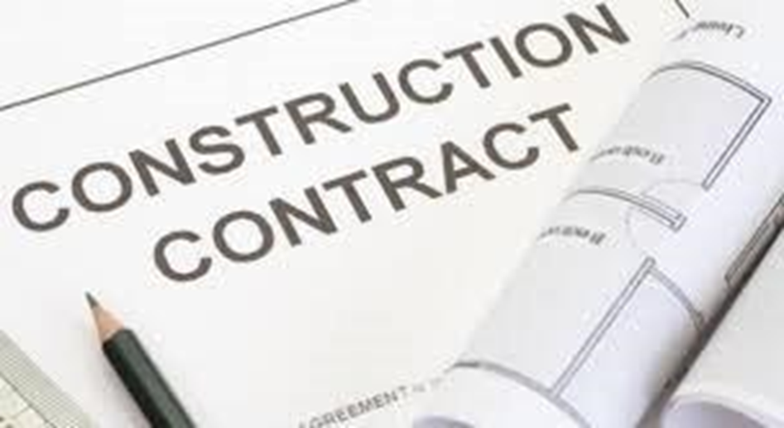
The Contract

Slide 7
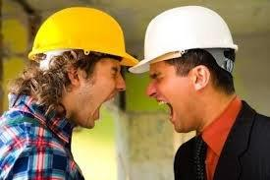
The Conflict

Slide 8
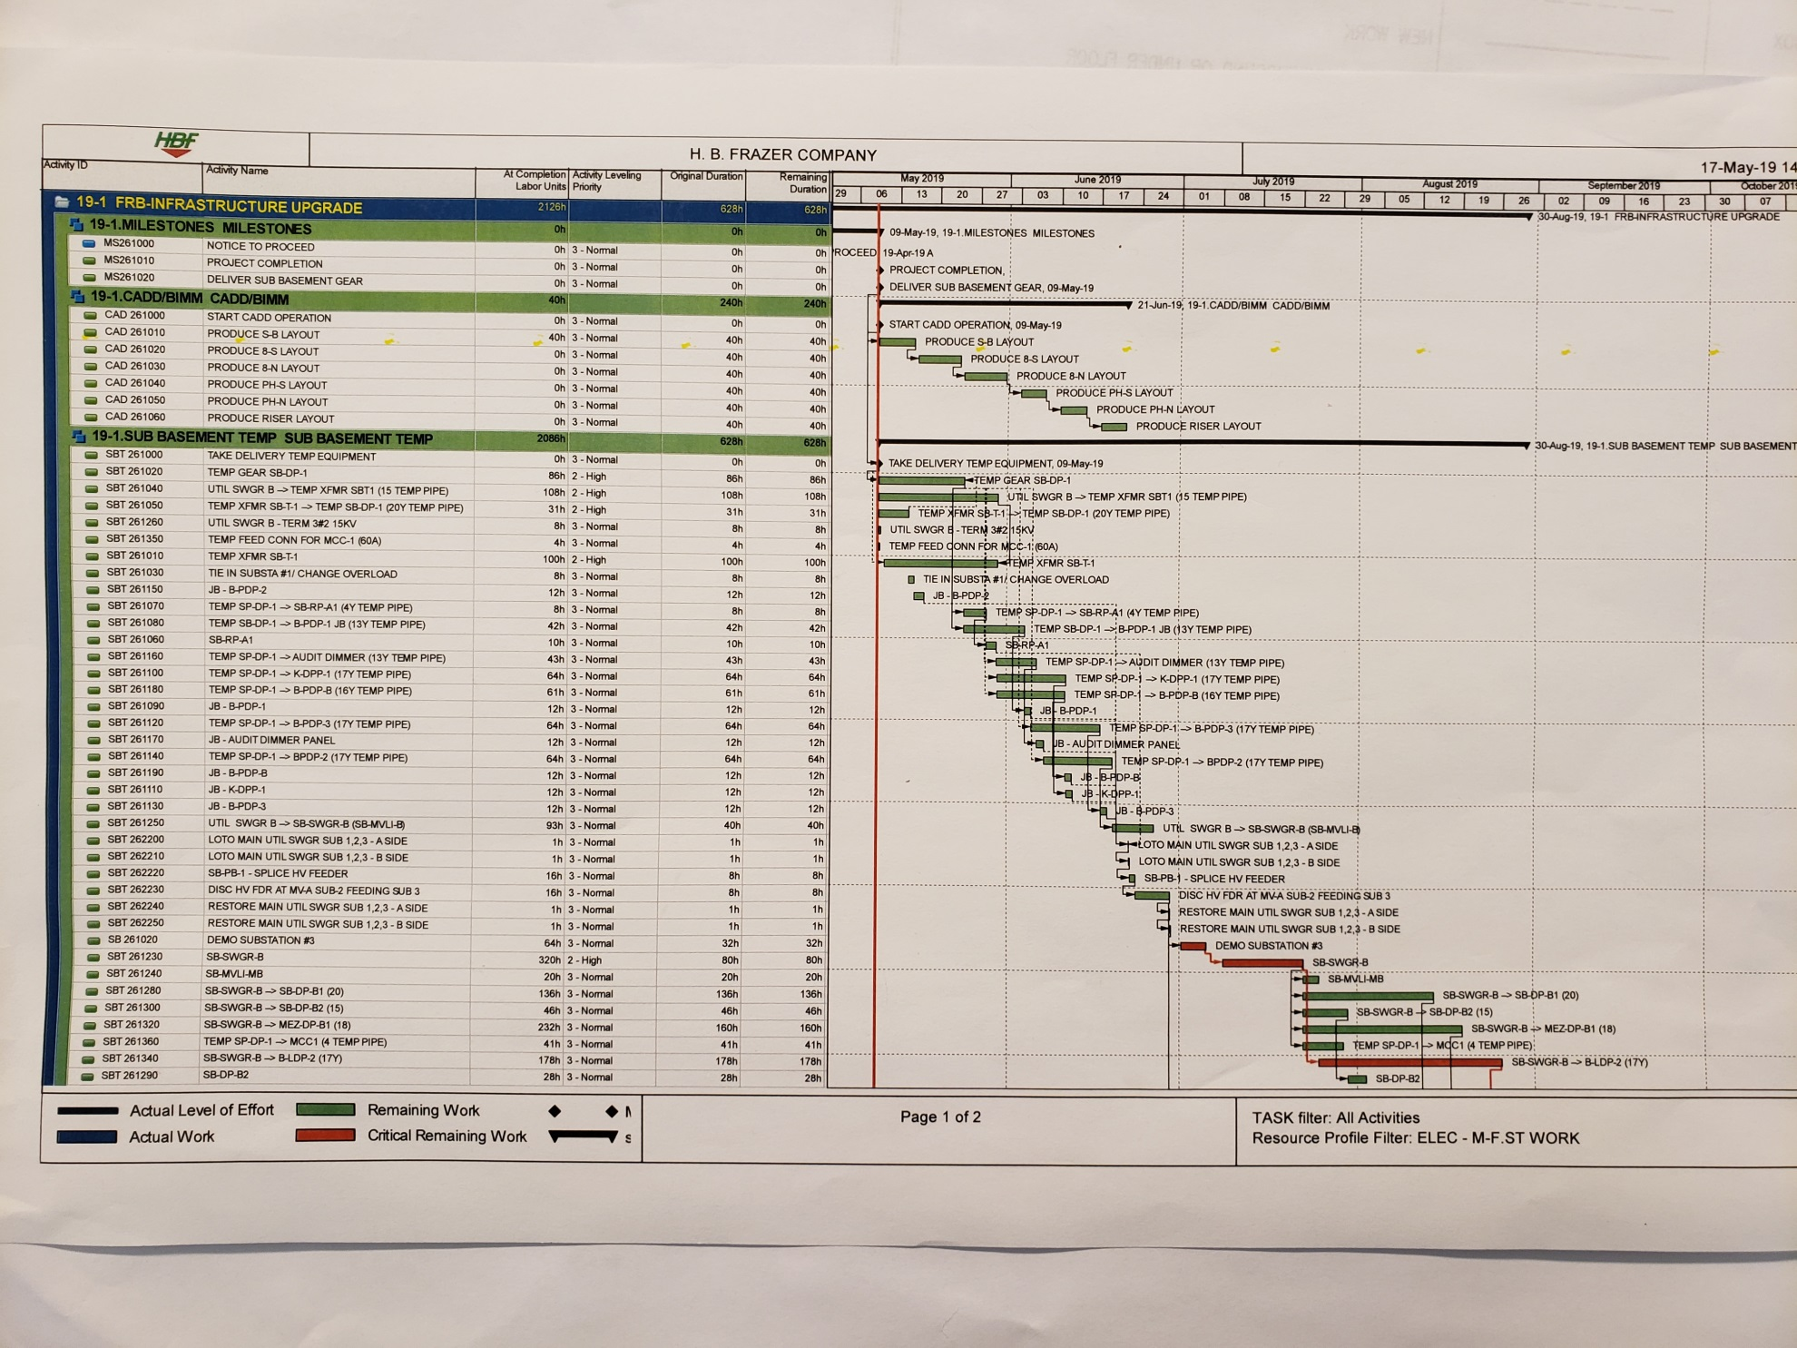
The Solution – Accurate Schedule

Slide 9
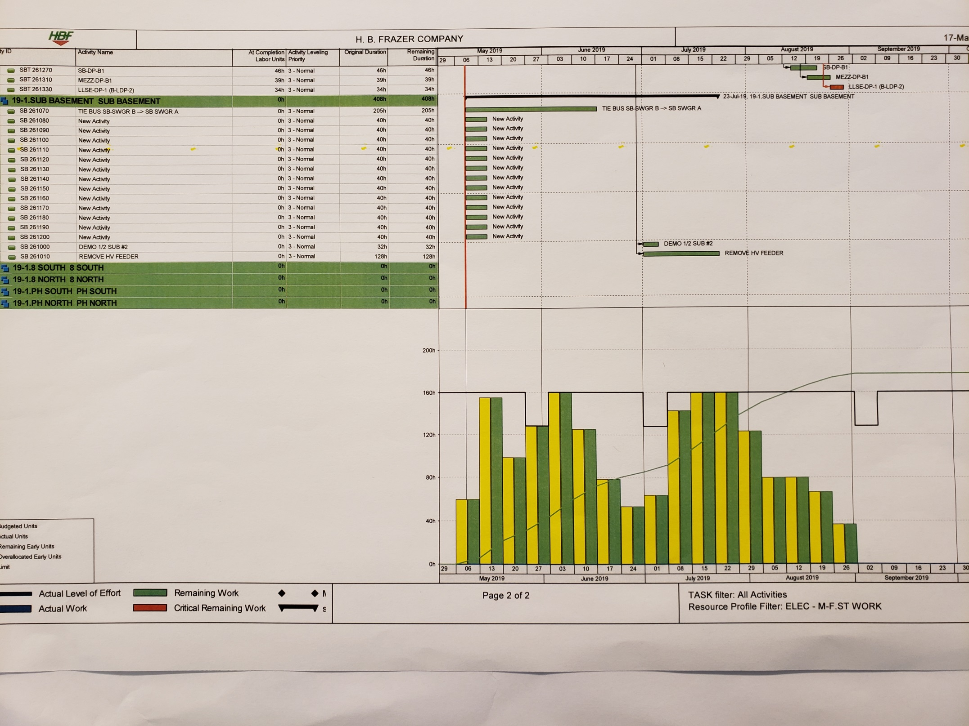
The Solution Man Power Loading

Slide 10
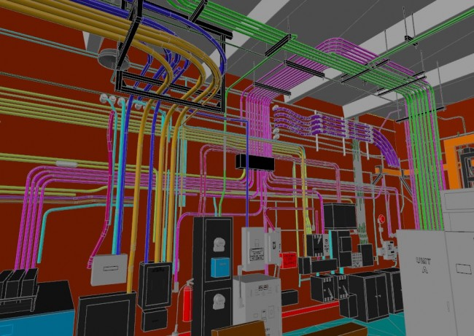
The Solution – BIM

Slide 11
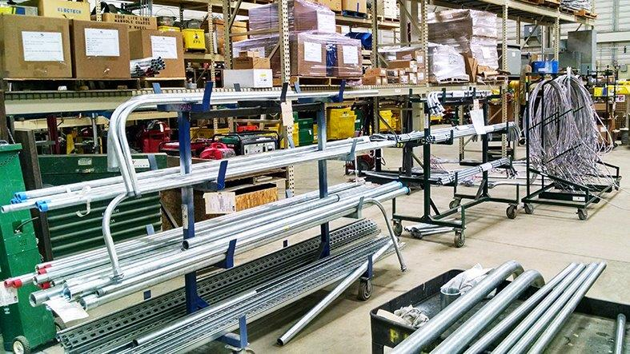

The Solution Pre Fabrication

Slide 12

The Solution – Supervision

Slide 13

The Solution – Accountability

Slide 14
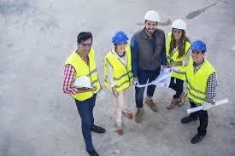
The Solution – Working Together

