Slide 1
Academy of Electrical Contracting | Fred Sargent

Slide 3
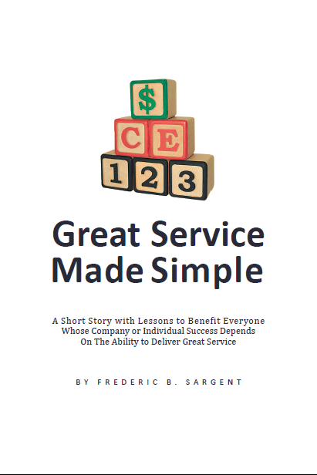
Great Service Made Simple

Slide 4
Recurring Revenues
Care & Effort
Preparation
Performance
Perpetuation

Slide 5
Great Service Made Simple

Slide 6
Professionally-Managed Service & Maintenance
AND THE FUTURE OF MID●SIZE ELECTRICAL CONTRACTORS

Slide 7
The “mid-size” category of union electrical contractors has been shrinking steadily.

Slide 8
That’s a nationwide concern for the union electrical contracting industry.

Slide 9
We see a remedy.

Slide 10
Balancing their revenue mix with a greater share of service work *

Slide 11
* Professionally-managed electrical service work

Slide 12
The routine requirements of service work match the skills of trained union electricians.

Slide 13
“Service” = problem-solving:
making things work.

Slide 14
1968

Slide 15
Rotation:
1,000 mph
Orbiting:
67,000 mph

Slide 16
How we classify what we do:
Commercial
Industrial
Residential

Slide 17
How we classify what we do:
Construction
Service
Maintenance

Slide 18
How we classify what we do:
Firm Price
Cost Reimbursable
Unit Price

Slide 19
How we classify what we do:
For Owner
For General Contractor
For Others

Slide 20
How we classify what we do:
Plans & Specs
Design-Build
As Directed

Slide 21
How we classify what we do:
Electrical
Low-Voltage
Specialty

Slide 22
How we classify what we do:
Will limit our vision, or open our eyes to new opportunities.

Slide 23
How we classify what we do:
Will determine the future of most of our companies.

Slide 24
What’s important is not about construction.
What’s important is all about compensation.

Slide 28
It’s not what we do that means the most.
It’s how we get paid that really counts.

Slide 29
How do you get paid for well-managed service work?
Profitably
Promptly
Recurringly

Slide 30
Properly-managed service work produces:
Predictable profits
Prompt payment
Recurring revenues

Slide 31
Properly-managed service work produces:
Early leads to sales & marketing opportunity
Valuation of your firm based on a multiple

Slide 32
Properly-managed service work provides:
a successful strategy for mid-size union electrical contractors.

Slide 33
Two-Part Strategy:
Adopt a professional service business model
Balance your annual revenue mix:
Service work > 40%

Slide 34
Consolidated Success:
Individually, union contractors gain & hold a loyal customer base
Industry-wide, union contractors gain & hold greater market share

Slide 35
2018
2025
Time to get going.
Time. to. read. results.

Slide 36
Never lose touch with a customer who somehow has managed to find you.

Slide 37
Thank You

